Slide 1



Blood on Board
10 Month Review
Dr Rachel Hawes
4th December 2015

Slide 2
Intro
Overview
Logistics
Clinical
Changes

Slide 3
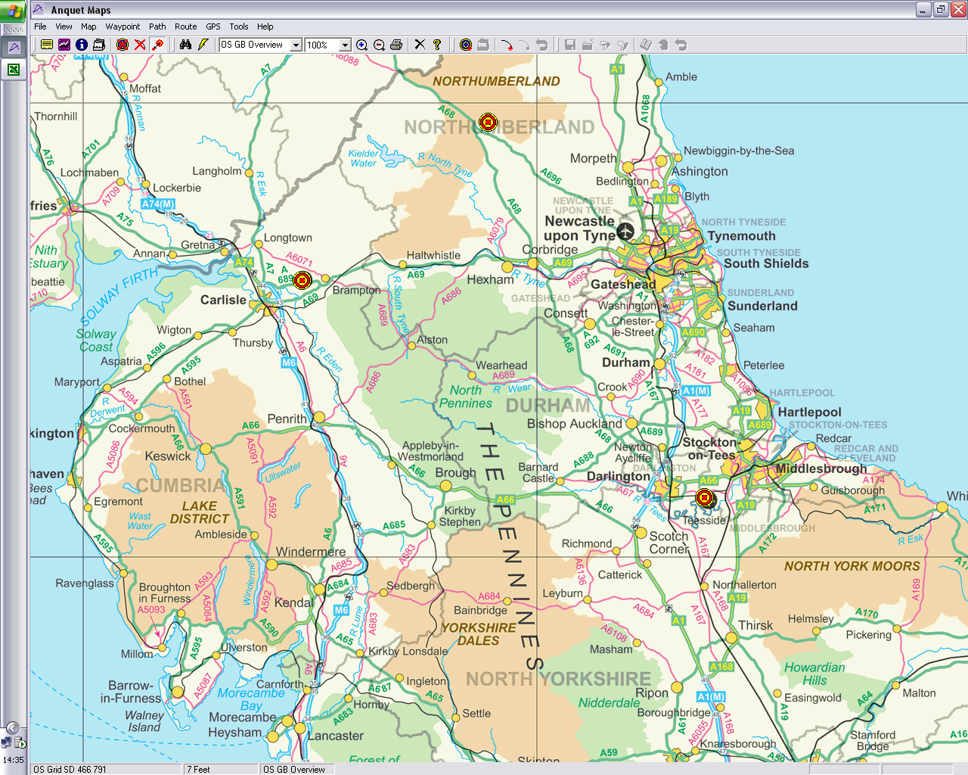
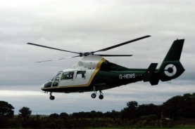
GNAAS
Established 2001
Regional Service
  NE, N Yorkshire, Cumbria
Large area
  Prolonged transfers
  Esp Cumbria & N Northumberland
365 days per year
Daylight hours
3 helicopters
2 cars
100% charity funded
  £4.5million per year
Severely ill and injured

Slide 4
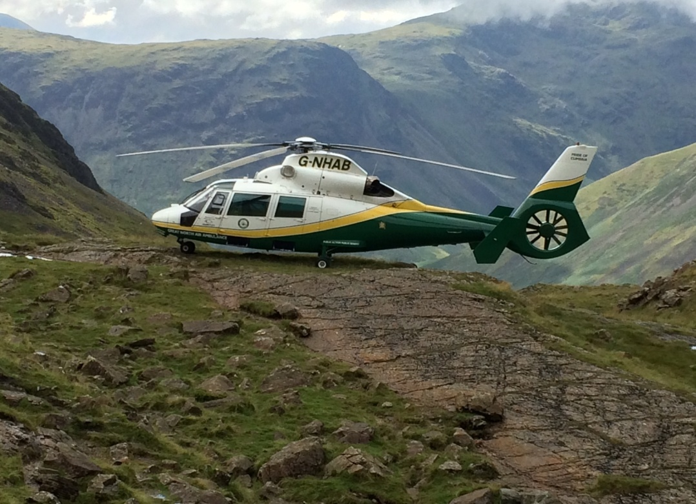
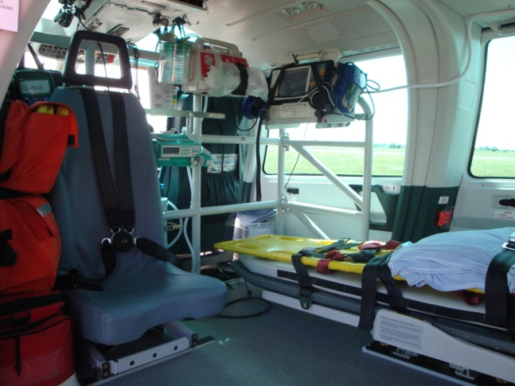
Eurocopter Dauphin
3 identical
Twin engine
140 km/hr
Largest civilian air amb
Full length access to patient
Land in small spaces
Not SAR - winch

Slide 5
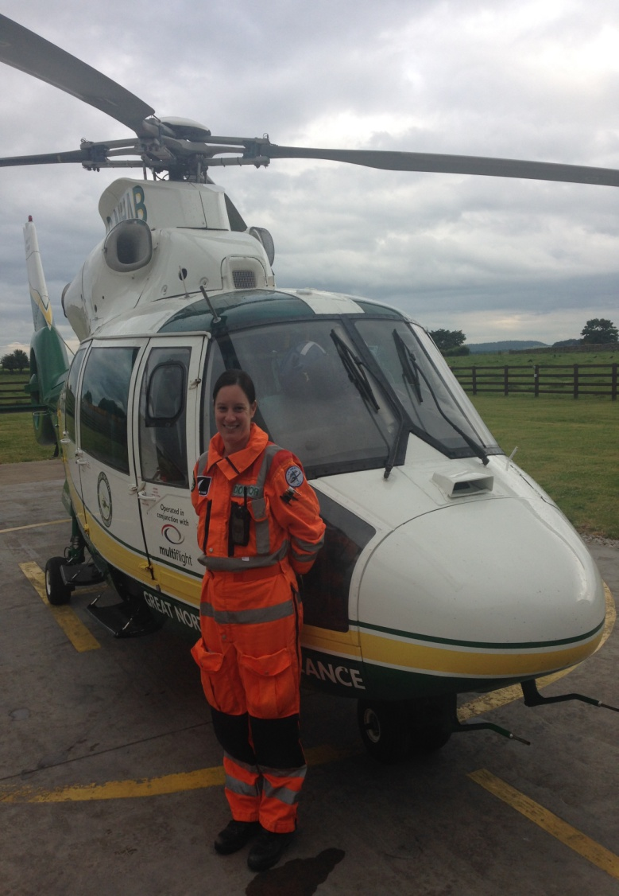
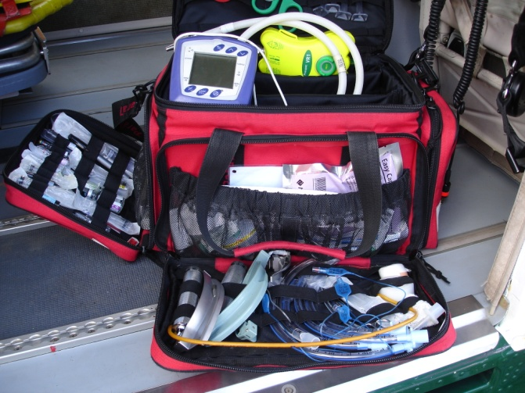
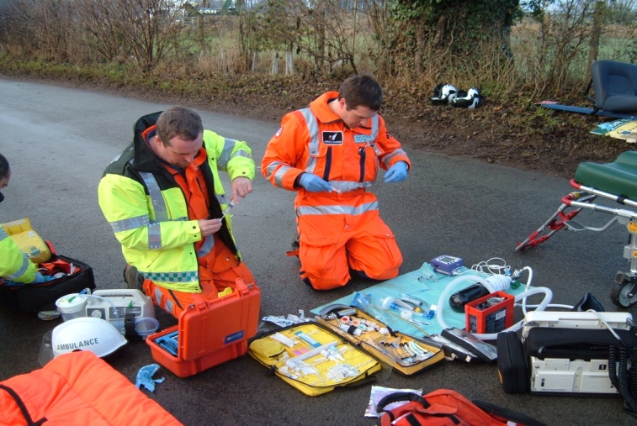
Medical Care
First Aid to Intensive Care

Slide 6
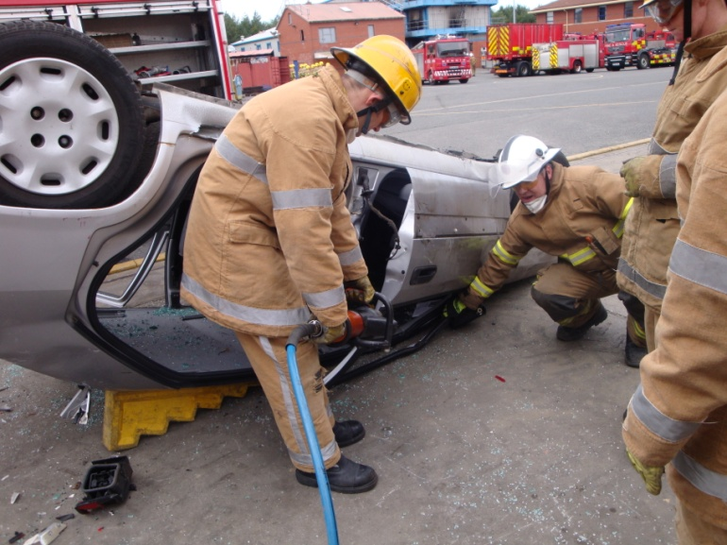



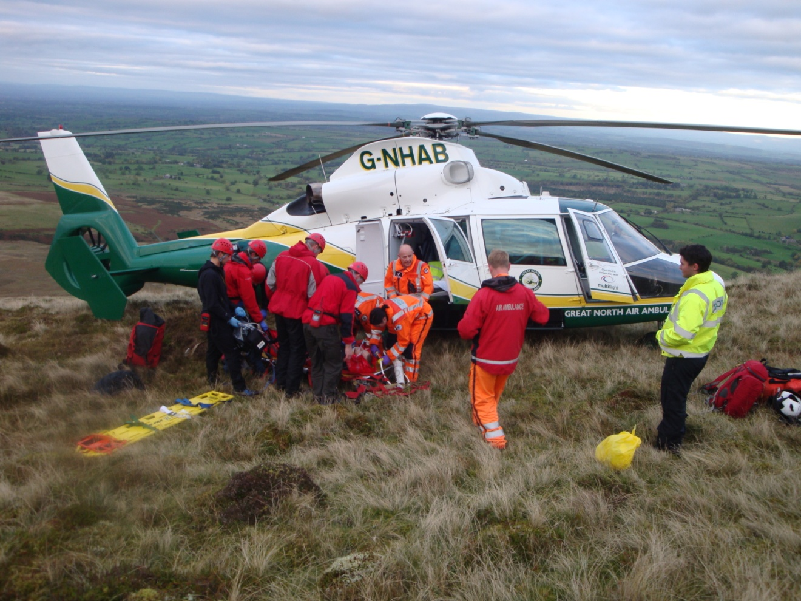
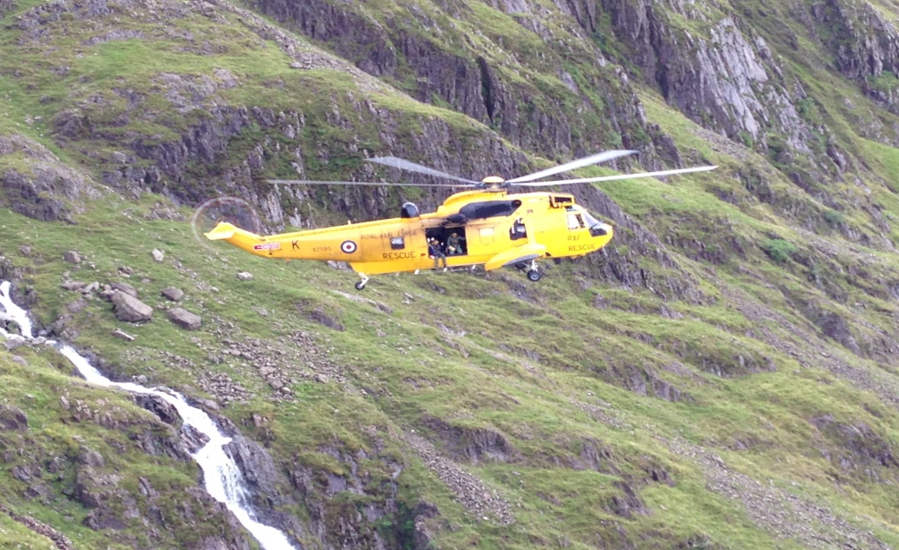
Team Work - Dovetail

Slide 7
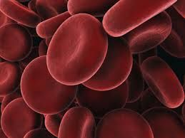
The bleeding trauma patient

Slide 8
Blood on board
Do we really need it?
Is it effective?
Is it safe?
Can we afford it?

Slide 9
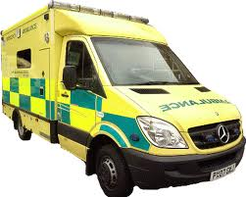
Blood on board
Do we need it?
  Haemorrhage leading cause of death
  999 to Emergency Dept 40mins
  25% already have bleeding problems

Slide 10
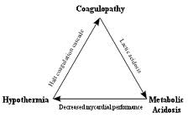
Lessons from the Military
Triad of trauma death
Stop Bleeding
Resuscitate patient
  Fluids
  Drugs
  Blood products

Slide 11
Issues
Legislation
Storage
Traceability
Documentation
Prehospital?
Constant temperature
Monitoring & Data log
Access
Protected
Weight v fuel
Power source
Air Worthiness ££££
Affordable for a charity

Slide 12
Blood on Board

Slide 13
Aims
Clinical
Logistic
Integrated, seamless care
  Point of injury to hospital care
Part of a ‘bundle of care’
Improved outcomes
Safe
  Do no further harm
Consistent & Reliable
  365 days per year
  Inclement weather
100% traceability
Minimal waste

Slide 14








Better Together

Slide 15
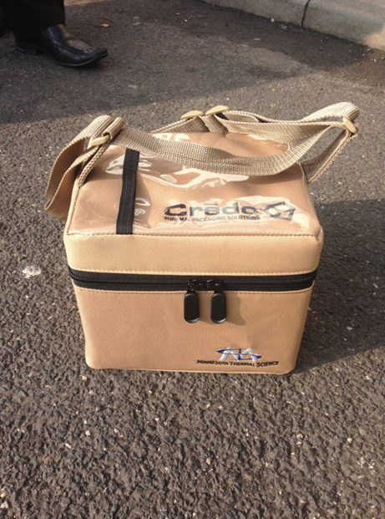
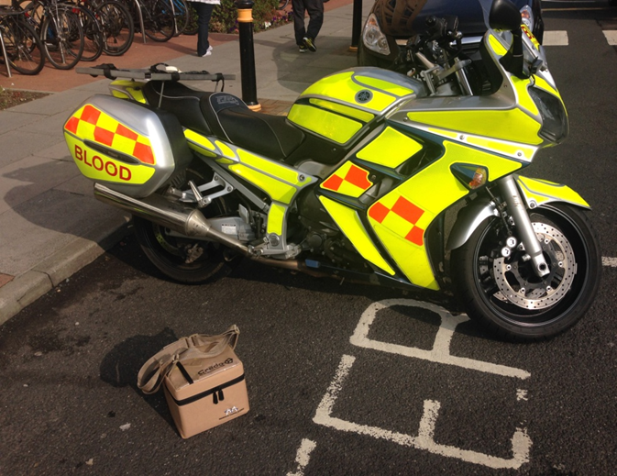
Logistics
Preparation – RVI Lab
Transport Route – Blood Bikes
Delivery – ‘Drop Off Locker’ –
  Sign in/out procedure for BB and GNAAS
  Fax to RVI from each base monthly
Collection of unused/ empty boxes
Documentation
  Trace unit from donor to recipient
  From patient back to donor
  Cool box performance

Slide 16

Costs!
Initial Set Up Costs
Annual Costs
Cool Boxes £2,500
Drop Off Boxes £2,000
Belmont, Buddy Lite Fluid Warmers £3,500
(Initial quote £40,000)
  Private
  NHS BT
  Subsidised Hospital Delivery
Charitable Donations
Transport £2-5,000
  Blood Bikes Free
  Inclement weather
Data Loggers £2,200
Wastage & Usage??
  £130 per unit
  £2000 wastage?

Slide 17
Logistics

Slide 18
10 Month Logistic Review
658 cool boxes prepared & delivered (incl 58 MERIT)
  100% delivery record (snow)
  100% accuracy of cool box tracking
  100% maintenance of cold chain (even at 2 x 72hrs)
56 units of blood given
  100% traceability
  No transfusion reactions
1257/1316 units of blood recycled

Slide 19
Time and Day
Day of the week
  Mon 3, Tues 6, Wed 5, Thurs 3, Fri 6, Sat 5, Sun 5
Busiest day – Tues & Fri
Quietest day –Mon & Thurs
50% occur between 16:00-18:00hr
Clustered around lunch time and rush hour
2 early morning

Slide 20
Destination of Patient
RVI – 18 patients
JCUH – 7 patients
Preston – 3 patients
Leeds – 0 patients
Direct to Mortuary – 5 patients
  NTGH x 2
  Durham x 2
  CIC x 1

Slide 21
Clinical

Slide 22
Demographics
Male = 75%
Mean Age = 43 years
Range = 14-79 years
Female = 25%
Mean Age = 54.6years
Range = 18-82 years
(2 young, all >60)

Slide 23
Mechanism of Injury
High Speed RTA – 88%
Stabbing – 6% (2)
GSW – 3% (1)
Crush – 3% (1)
Injury Pattern
  Isolated injury – 5%
  2 body cavities – 35%
  3 body cavities – 15%
  4 body cavities– 15%
  Traumatic Cardiac Arrest – 30%

Slide 24
10 Month Clinical Review
33 cases in 10 months (one every 1-2 weeks)
Correct patients treated
  Multiply injured
  CVS instability
  Traumatic Cardiac Arrest
  Significantly deranged pH/ BE/ Lactate
  Abnormal clotting on presentation
  Significant on-going transfusion requirements in hospital
8 unexpected survivors

Slide 25
Logistic Summary
Used every 1-2 weeks
100% delivery, tracking & cold chain maintenance
100% traceability of units given
56 units given
3 units wasted
1257/1316 units of blood recycled

Slide 26
Gains!
Develop an Integrated Trauma Service
  Professional, evidenced based, well managed change
Improvement in patient care
Improved working relations with neighbouring assets/ other leaders in healthcare
Publicity
  Media engagement
Fundraising?

Slide 27
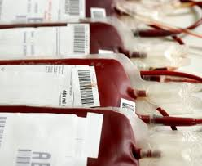
Summary
Thanks!
Logistics Plan
  Robust & sustainable
  100% Traceability
  Minimal wastage
Clinical Care
  Appropriate use
  Increase in survivors

Slide 28
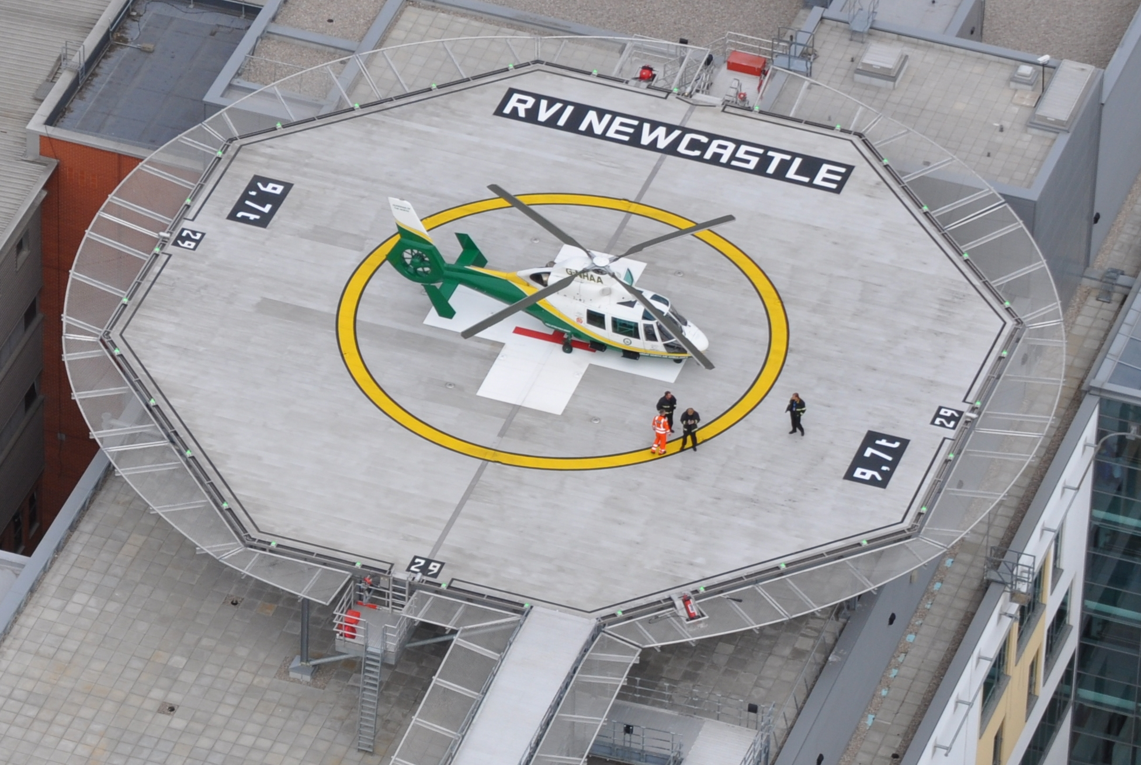
THANK YOU
ANY QUESTIONS?

