Slide 1
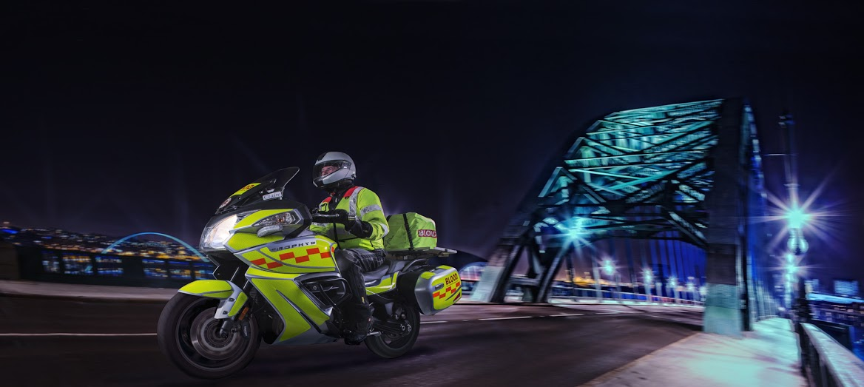
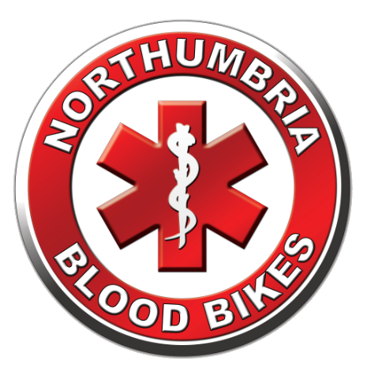
Northumbria Blood Bikes
Notes:
Hello My Name Is
I’m a Rider / Driver / Volunteer with Northumbria Blood Bikes
Thanks for the opportunity to share our story with you
Straw Poll – “how many of you have heard of us or know what we do”

Slide 2
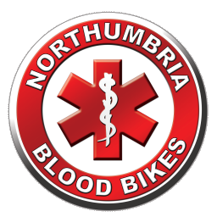

Who are we? What do we do?
NORTHUMBRIA BLOODBIKES
We are a local charity .
We provide an out of hours emergency courier service to North East hospitals and other healthcare sites
We are independent of the NHS although we provide a service to them.
Charity Commission Registration
“To advance health or save lives, primarily in Northumbria, by providing a volunteer courier service ancillary to transport provided by the statutory authorities for the transfer of blood, blood products and other medical resources between hospitals and medical facilities."
Notes:
We are a charity.
When NHS couriers go home, hospitals used to rely on taxis or couriers to move urgent items out of hours.
We are not part of the NHS, or Blood Transfusion Service, but an independent charity.
Our charitable aim is to improve health and save lives.

Slide 3
Background & History
NORTHUMBRIA BLOODBIKES
Blood Bike groups have existed for 40+ years
Volunteer led, free out-of-hours service
Carry blood, blood products and other urgent items
2009: Nationwide Association of Blood Bikes (NABB) established
2012: Member groups carried out 25,000 runs for the NHS
2012: Northumbria Blood Bikes is formed in September
2013: 22 bloodbike groups across the country
2014: NBB began live operations in February
2016: 35 independent Blood Bike groups across the country (27 NABB Members) – covering almost all of the UK.
Notes:
Only the North of Scotland is not covered.
A group is forming based in Aberdeen to cover the NE of Scotland
Of the 8 groups that are not members of NABB, many are working towards the standards required for membership

Slide 4
What do we do?
NORTHUMBRIA BLOODBIKES
We deliver urgent Blood, Platelets, Specimens, Fluids, Equipment.
We recruit, train, and motivate volunteers to work with us
We run a fleet of around a dozen vehicles
We organise fundraising and awareness events, and solicit donations, sponsorship and publicity from.. Anywhere and Anyone!
We do our own publicity: Newsletters, radio & TV interviews, banners, posters, promotional items, talks & presentations
We negotiate with Health Trusts, NEAS, NHSBT, GNAAS.
We are accountable; we record statistics, legal administration, evidence-backed with receipts, activity logs & recordings.
Notes:
Delivering to hospitals is the visible part of our service, our equivalent of a duck on the lake
Everything else is what it takes to enable the delivery service – paddling like mad under the water.

Slide 5
Our Coverage:
NORTHUMBRIA BLOODBIKES
We cover 7pm to 7am, every day, 365 days per year.
We also work around the clock on weekends & public holidays
We cover Northumberland, Tyne & Wear, Durham and Darlington.
From Berwick to Darlington & DTV thru Barnard Castle, & Hexham to Sunderland and North Tyneside
Notes:
The map outlines our region
It is more or less the medieval kingdom of Northumbria. (Originally it included North Yorkshire hence “North of the Humber Area”)
We can do relay runs with neighbouring groups.

Slide 6
Our Funding:
NORTHUMBRIA BLOODBIKES
Our service is completely free of charge to the NHS
Nobody takes a salary..... every member works for free.
Funded wholly by donations from the general public, sponsorship & events. No government or NHS contribution.
Hundreds of Thousands of £££s saved in taxi & courier costs - which can be re-invested into patient care, equipment, extra nurses etc.
Notes:
We are led to believe that just one of the Trusts in the North East saved over £50,000 last financial year as a result of NBB.

Slide 7
Why use Motorbikes?
NORTHUMBRIA BLOODBIKES
Good for negotiating traffic congestion due to filtering ability
Riders can use "No Car" lanes
Motorcycles provide better fuel economy, reducing costs.
We promote the positive image of motorcycling, hopefully changing people’s perceptions and allowing them to see riders in a more positive light.
Through our rigorous training requirements, we are putting safer riders onto the roads, with over 100 riders having taken advanced rider training and slow riding technique training.
However, we use cars too: When ambient temperature falls below 3º C regulations prohibit carriage of whole blood by motorcycle. We also use cars/vans for carrying equipment and towing our trailers.
Notes:
Filtering is legal in the UK We can use “no Car” or Bus lanes except in Gateshead who don’t/won’t allow it. In Newcastle we have dispensation for our cars to use the No-Car lanes in Emergencies

Slide 8
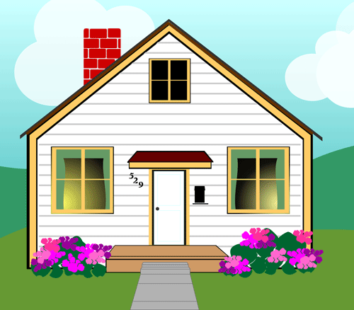
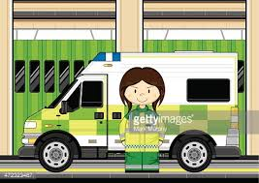

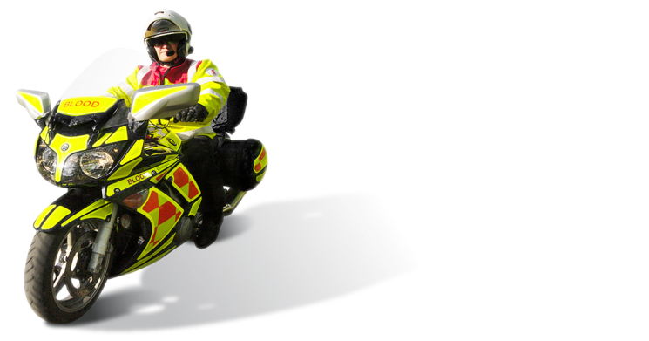
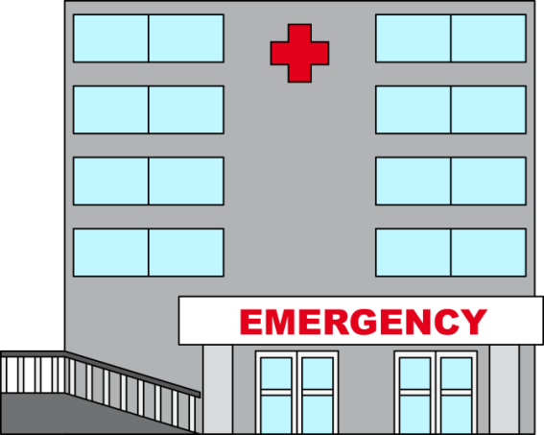
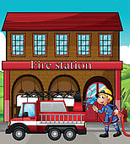
NORTHUMBRIA BLOODBIKES
How it works:
Our vehicles are based around the region.
Mostly at Ambulance and Fire stations.
A member will have booked a shift in advance and chosen a vehicle to use.
Rider drives his own vehicle to the base hosting the vehicle for his shift.
Rider checks over the blood bike ready for the shift to start.
If the base station has a crew room, the rider can wait there for a callout.
Otherwise they may return home and wait there for a callout.
Alternatively they may wait for a callout at one of the hospitals.

Slide 9
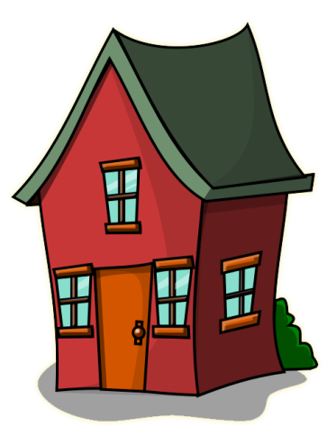


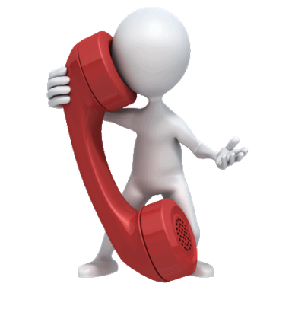
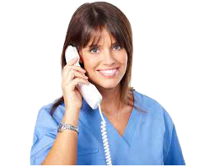

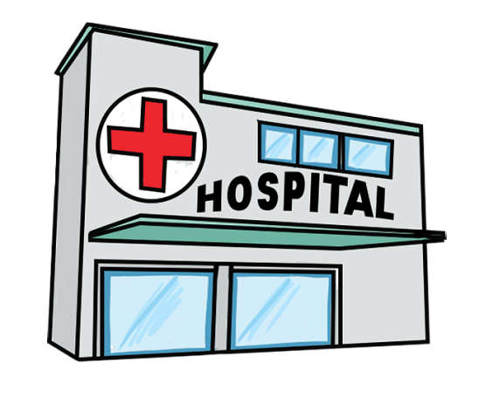

NORTHUMBRIA BLOODBIKES
How it works:
We have a “virtual number” in the cloud for hospitals to call us.
Our volunteers can redirect the number to their home phone.
Hospitals call our ‘hotline’ number, our volunteer gets the call.
We take the details of the job, and pass them to a rider / driver.
Rider / driver collects and delivers the package keeping controller informed.

Slide 10
The information we need:
NORTHUMBRIA BLOODBIKES
From the Hospital: For our records / traceability:
WHERE FROM ?
Time of hospital CALL
WHERE TO ?
Name of person assigned
WHAT IS IT?
Time job was assigned
HOW URGENT?
TIME COLLECTED
NAME?
TIME DELIVERED
CONTACT NUMBER?
TIME Stood down!

Slide 11
Operating Methodology:
NORTHUMBRIA BLOODBIKES
Members all carry photo I.D.
All have an advanced riding or driving qualification
Riding / Driving is assessed annually
All receive GMP Blood Handling training
Trained to use “blue lights” in emergencies
Members use dedicated, liveried, vehicles - not their own.
Tracking devices fitted which alert on speed infringements, or alert shift controller of any problems.
Employer & Public liability insurances in place
All paid for by fundraising, no NHS contribution.

Slide 12
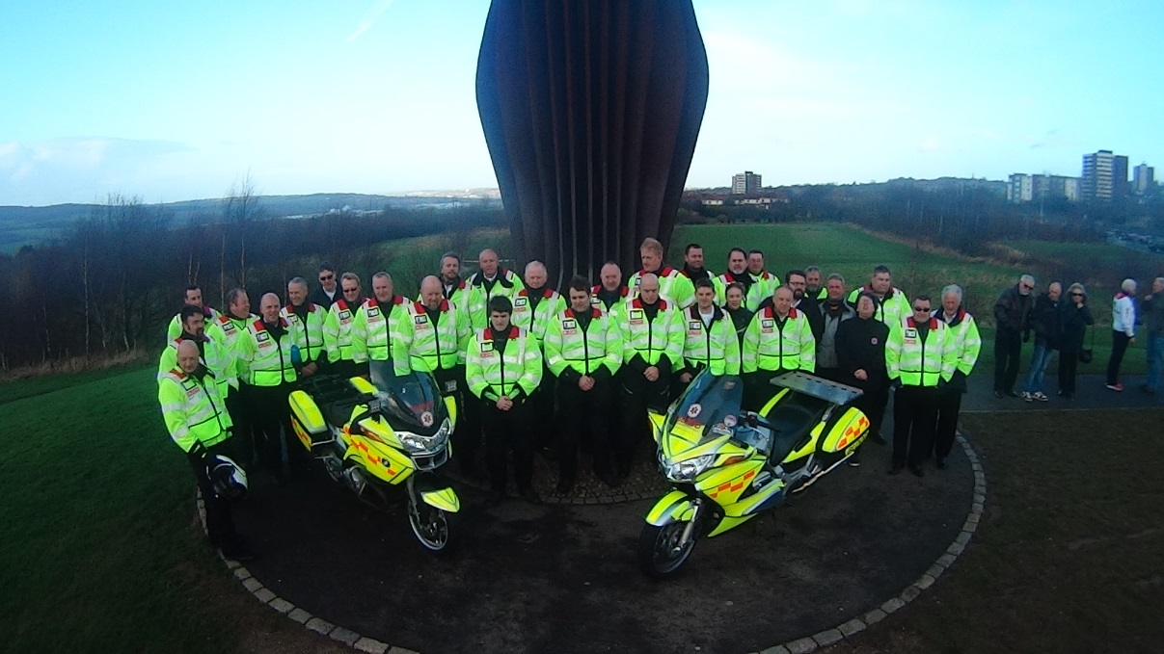
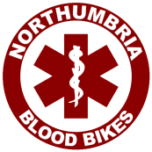
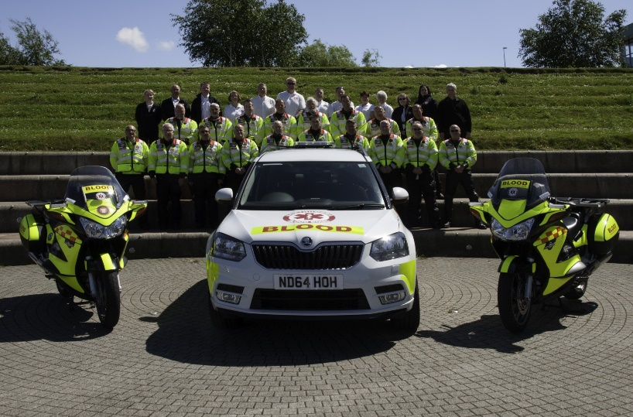
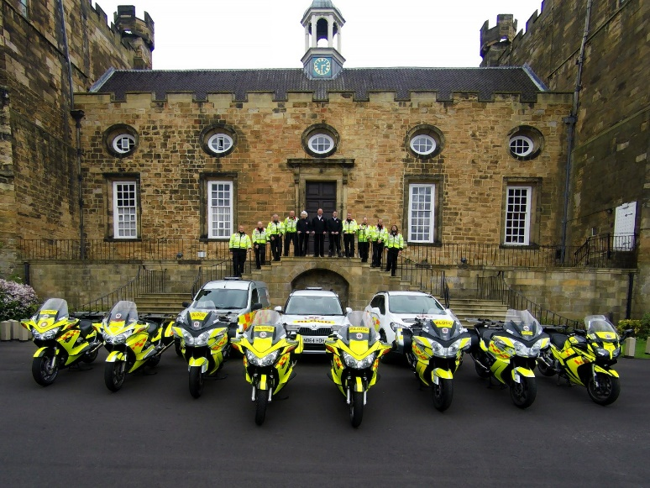
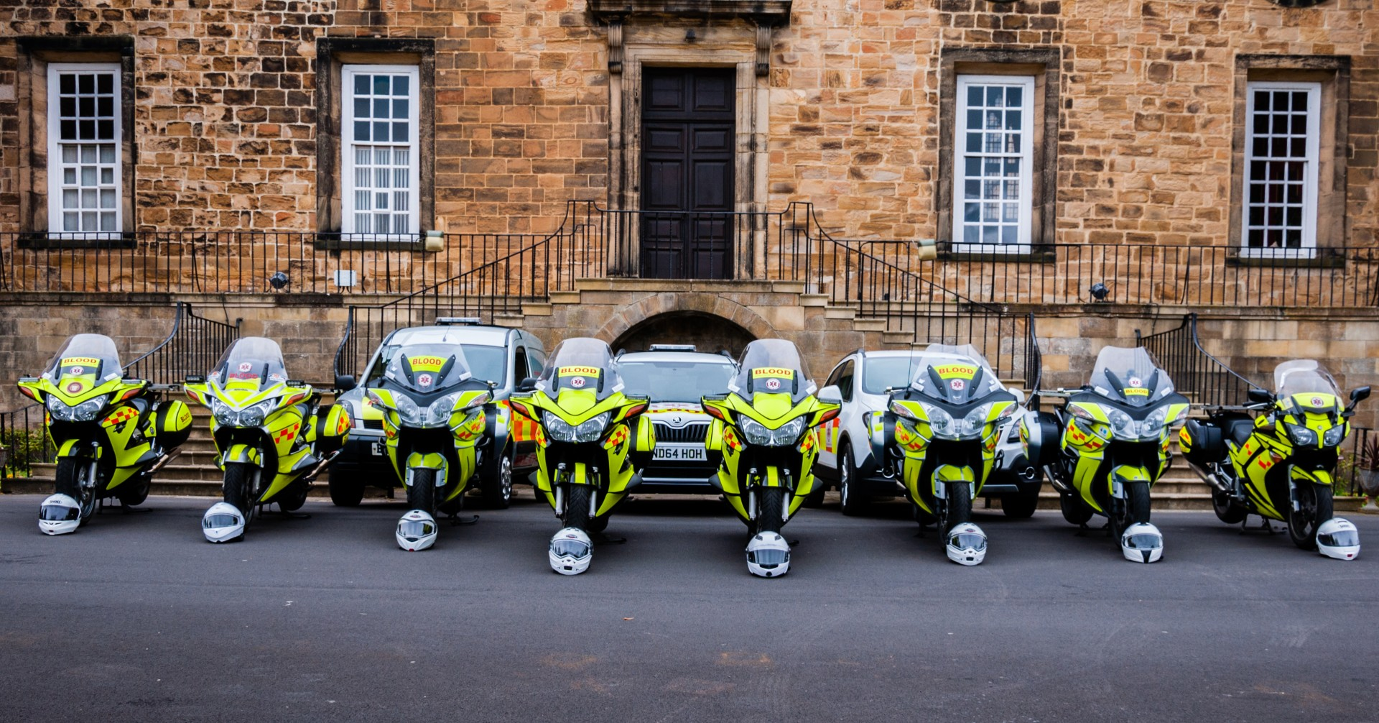



Angel of the North Gateshead.
Sunday 2nd February 2014
(The day before we launched)
Registered Charity no. 1166689
www.northumbriabloodbikes.org.uk
Notes:
At the time of the photo (Feb 2014) this represented the complete fleet of vehicles - 2 motorcycles
there are 31 people in the photo (plus two taking photos) that represented about 90% of the membership at the time
Earlier this year we refreshed the group portraits.
You can see the fleet has grown considerably
However, as it was the summer holiday period, we still only had around thirty members at the photoshoot – only now it represented between around 5% of the group.
Even these photos are already out of date – we’ve added another car, one of the bikes has been replaced.

Slide 13
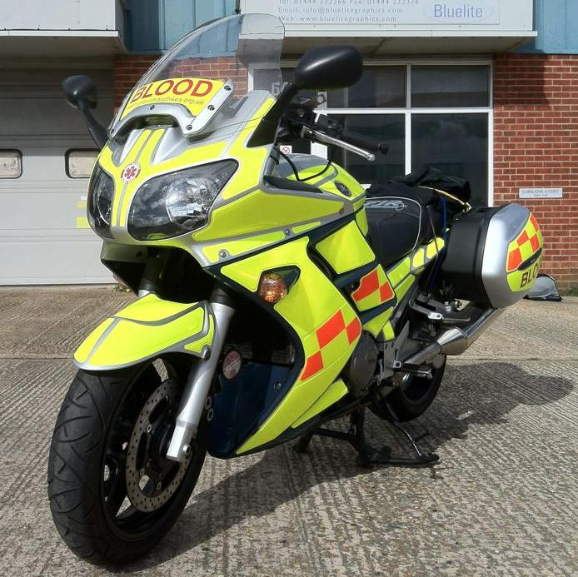
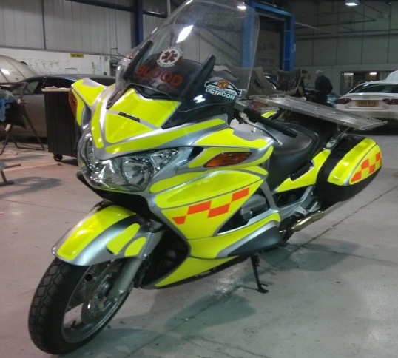
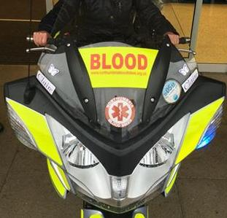
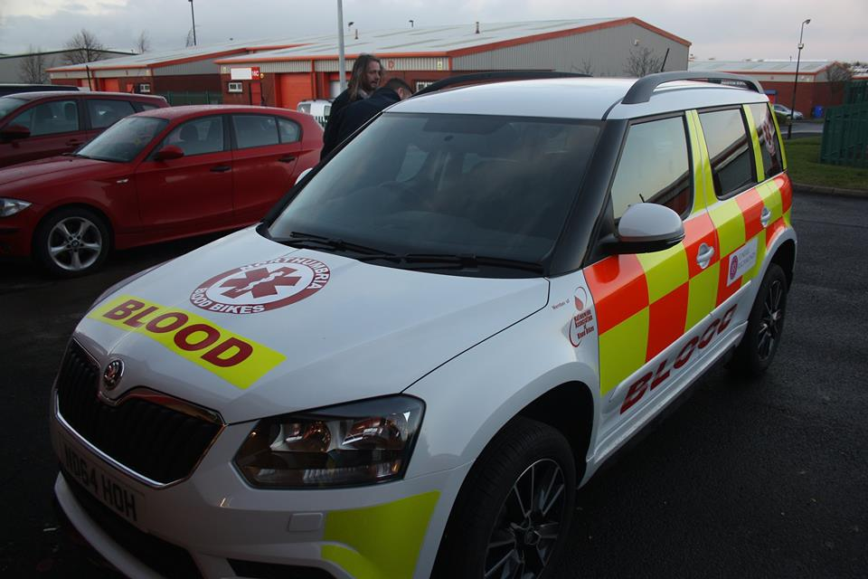
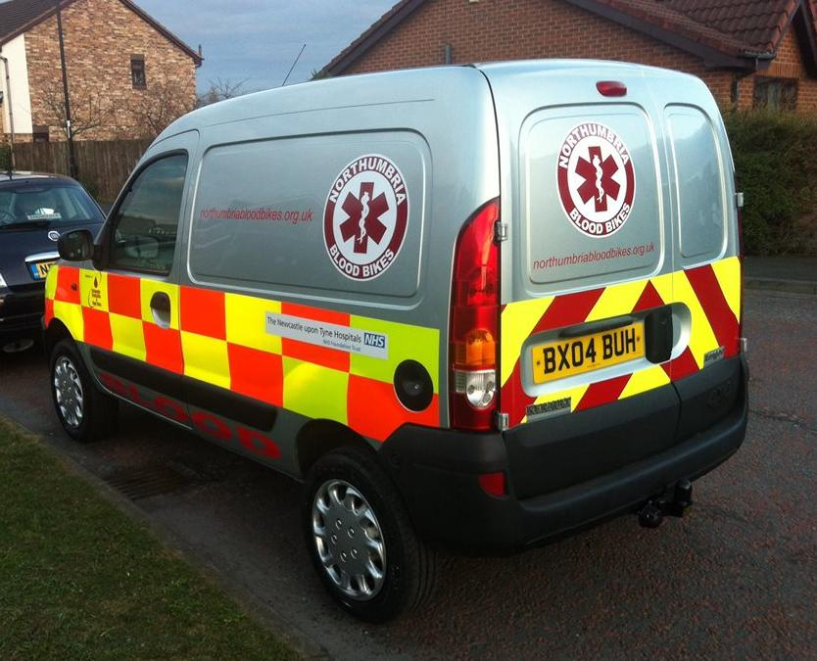
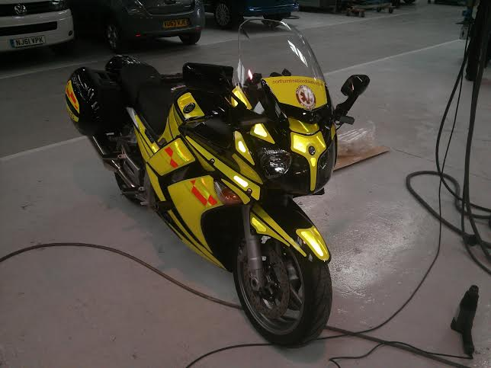
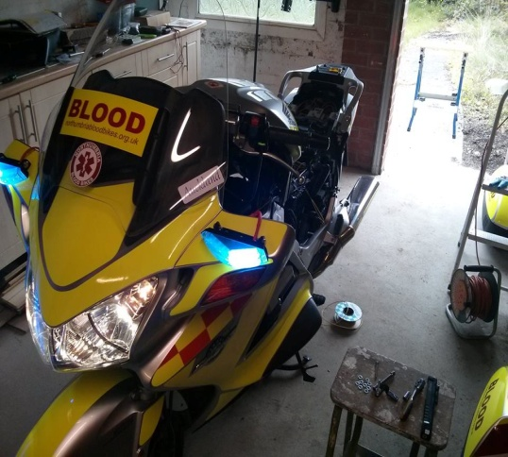
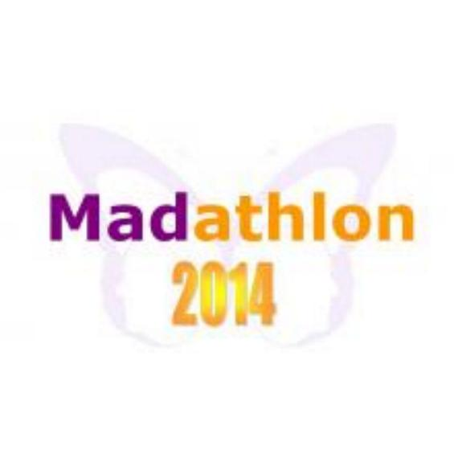
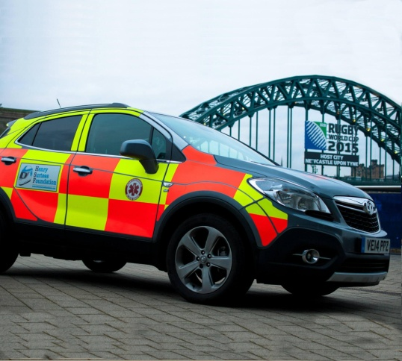
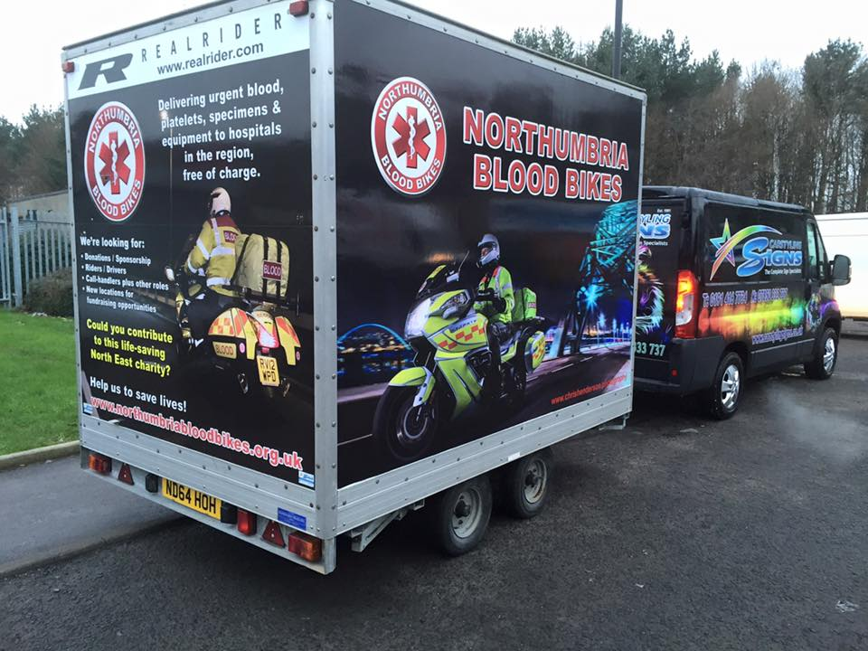
NORTHUMBRIA BLOODBIKES
Our Vehicle Fleet:
2 x Yamaha FJRs
4 x Honda ST1300 Pan Europeans
3 x Triumph Trophy.
2 x Skoda Yeti
1 x Vauxhall Mokka
1 x Renault Kangoo
1 Exhibition trailer.

Slide 14
Membership:
NORTHUMBRIA BLOODBIKES
570 Members in total.
300+ Riders, of which
150+ are advanced qualified
96 are on the riders register
286 Drivers, of which
129 are advanced qualified
53 are on the drivers register.
(32 members are on both registers).
69 x Shift Controllers trained.

Slide 15
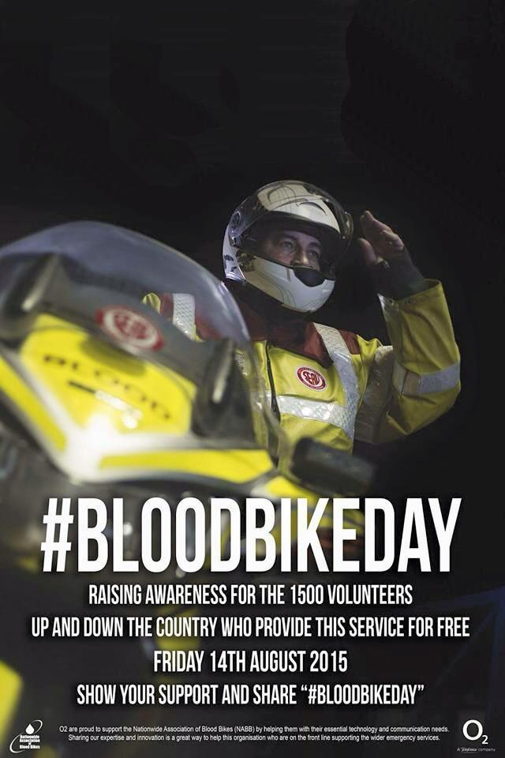
NORTHUMBRIA BLOODBIKES
Highlights:
Aug 2016: 2nd annual "National Blood Bike Awareness Day"
Involvement from groups across the country, with television, radio & press coverage.
Awareness stands around the region
Substantial increase in membership enquiries in the days immediately after the event.
Northumbria Blood Bikes innovation

Slide 16
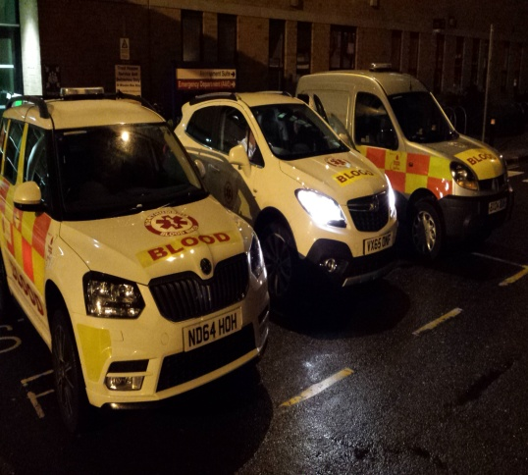
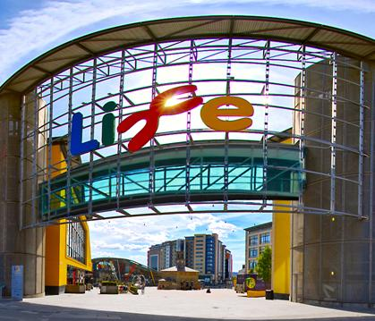
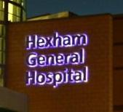
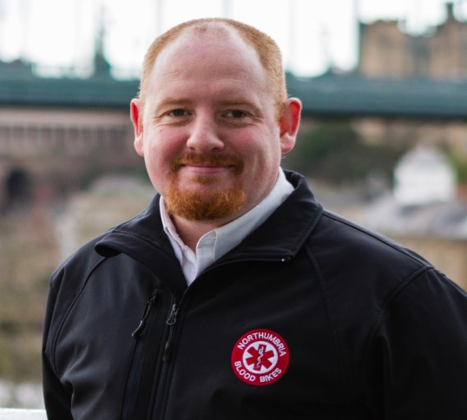
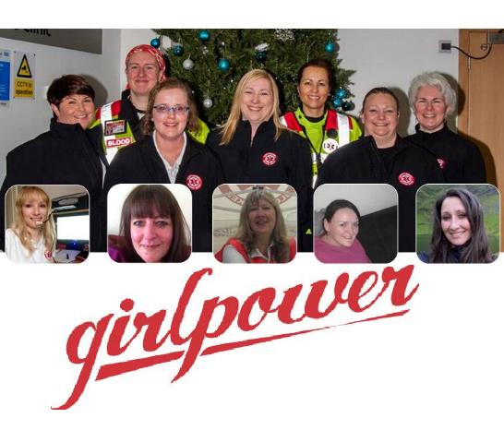
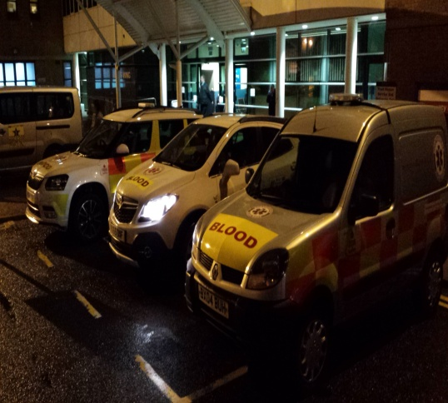
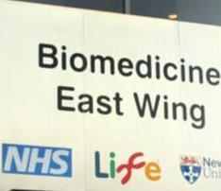
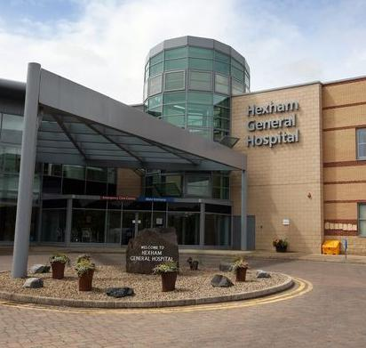
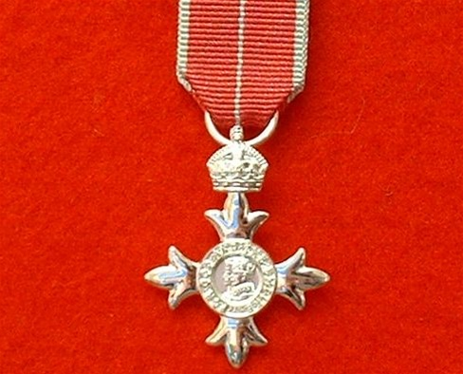
NORTHUMBRIA BLOODBIKES
Highlights:
Now operating 2-3 vehicles each shift
Taking jobs from Newcastle’s Centre for Life
Regular scheduled runs from Hexham.
One of our founder members, Barry Bullas, recieves an MBE "For services to charity“.
February 2016: 250,000 duty miles covered!
August 2016: 10,000 jobs completed!
Boxing Day 2016: 2nd all-female shift.
Celebrating
Deliveries for the NHS
since Feb 2014
10,000

Slide 17
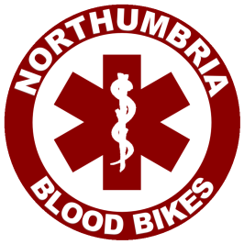
NORTHUMBRIA BLOODBIKES
NORTHUMBRIA BLOODBIKES
Recent updates:

Slide 18
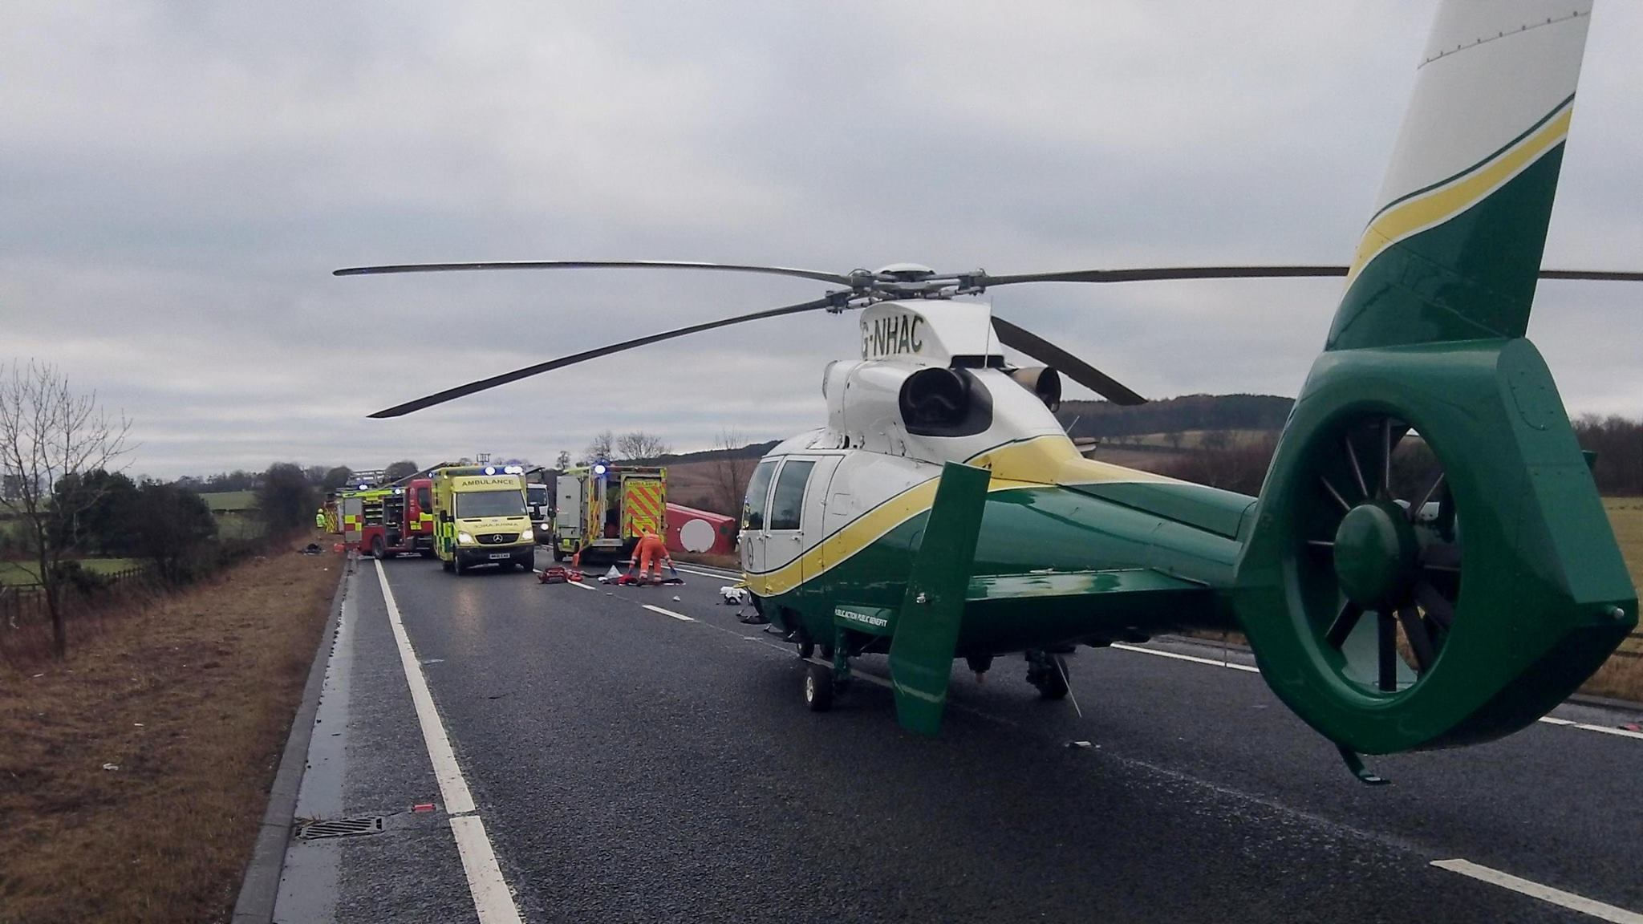
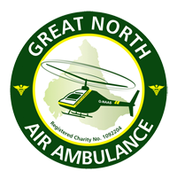
NORTHUMBRIA BLOODBIKES
"Blood On Board" ("BoB")
"The delivery of blood, daily, to each of the two Great North Air Ambulance helicopters, to enable blood transfusions at the scene of an accident instead of waiting until the patient reaches a hospital"
Idea came from frontline military field hospitals in Afghanistan
Only group "O negative" blood used - can be used for any blood type
Specially insulated storage boxes maintain temperature for 48 hours
In-built electronics show if box temperature has breached thresholds
Blood transfused at scene is heated to body temperature "on the fly"
Unused blood is returned to hospitals before temperature drops, so that it can go back into refrigeration for use in operations: No waste!
Relays with another blood bike group to reach furthest base (Penrith)

Slide 19
NORTHUMBRIA BLOODBIKES
NORTHUMBRIA BLOODBIKES
"Blood On Board" ("BoB")
An update on the BoB project from GNAAS:
1st used within 24hrs of launch in Jan 2015.
60+ transfusions, one third of which contributed to survival
1250 cool boxes prepared, delivered & collected by blood bikes
100% delivery record, 100% accuracy of cool box tracking,
100% maintenance of cold chain (including 2 at 72hrs).
100% traceability, No transfusion reactions.
So successful, scheme has expanded to include a MERIT car.
18 “unexpected survivors” directly attributed to BoB scheme.
Notes:
Update April 2016
Eighteen lives have been saved as a result of air ambulances carrying blood on board, the charity has said.
The Great North Air Ambulance Service (GNAAS), which covers the North East, Cumbria and North Yorkshire, started the scheme in January 2015.
Since then, medics have performed 60 transfusions, a third of which were deemed to have been of critical importance to survival.
Many others have had their outcomes improved by having the intervention.
Update sept 2016 –
1250 coolboxes delivered: figures from from NBB records

Slide 20
NORTHUMBRIA BLOODBIKES
"Blood On Board" ("BoB")
"The Great North Air Ambulance Service relies entirely on the Blood Bikes charity to deliver blood products to our two air bases in the North East and North West of England. The service they provide is extremely professional, reliable and without their service we would be unable to provide pre-hospital blood transfusions at the roadside to critically injured patients. Blood Bikes was the only organisation capable of meeting our needs and we have been impressed with every aspect of their service, from the training and qualifications of their riders, to the flexibility and “can do” attitude of their team. We are aware that this service is dependent on external charitable funding and would sincerely encourage potential donors to support this life-saving organisation."
Dr David Bramley, MBChB, FRCS(A&E)Ed, FCEM, FIMC RCSEd
Medical Director, GREAT NORTH AIR AMBULANCE SERVICE

Slide 21
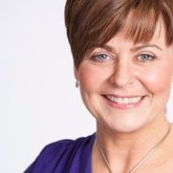
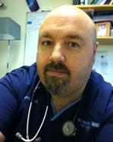
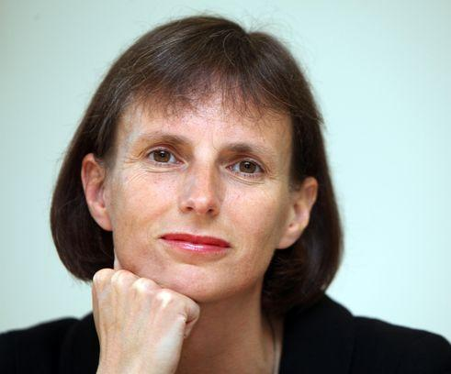
Patrons:
NORTHUMBRIA BLOODBIKES
Carol Malia BBC Television Presenter, Deputy Lieutenant of Northumbria
Bob Jarman MBBS MSc FRCS(Ed) FCEM FRCP(Ed) CFEU Consultant in Emergency Medicine
Heidi Mottram OBE CEO, Northumbrian Water

Slide 22
Feedback:
NORTHUMBRIA BLOODBIKES
"Before today I had no Idea that this organisation existed, and realised very quickly that these could have been the people who helped to save my 2 year old niece’s life this year because of transporting the blood she needed when the hospital she was in ran out of her type of blood in the middle of an operation.
Thank you so much XXX”
Carys Aston, passer-by at a blood bikes fundraising event at an ASDA store

Slide 23
Feedback:
NORTHUMBRIA BLOODBIKES
“A friend of my mother was taken by ambulance to Cramlington hospital last night and was given an emergency blood transfusion. On questioning the staff at hospital, my mother was informed that the blood was brought up specifically for her friend and it arrived by motorbike.
Without this it is unlikely she would've survived. So on behalf of my mother (who is an emotional wreck), her friend who had the transfusion, and most importantly her children who would've lost their mother: A huge thank you and all their love to all of you.
Thanks guys and gals, you rock!”
Posted on our Facebbook page by Paul Bainbridge.

Slide 24
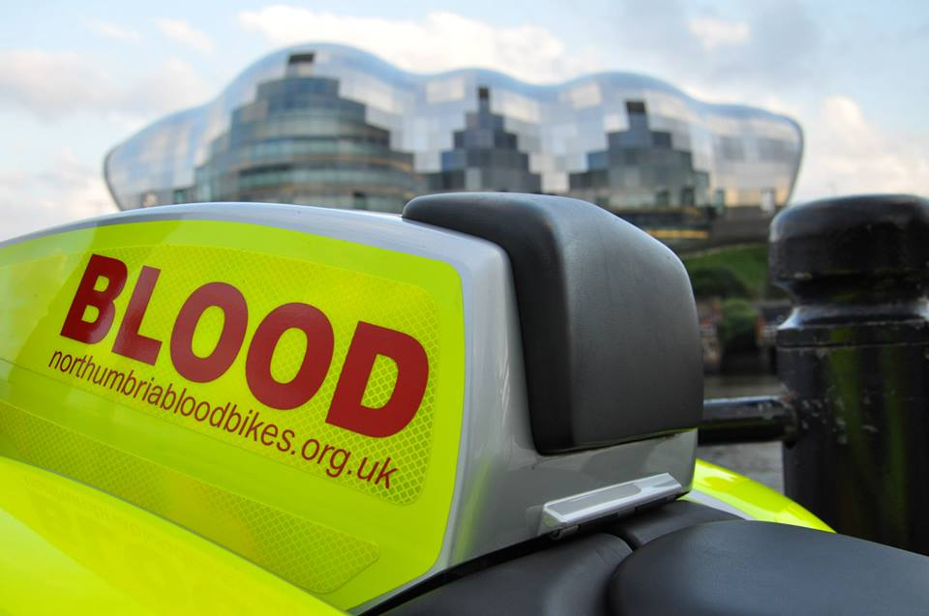



Registered Charity no. 1166689
www.northumbriabloodbikes.org.uk

