Slide 1
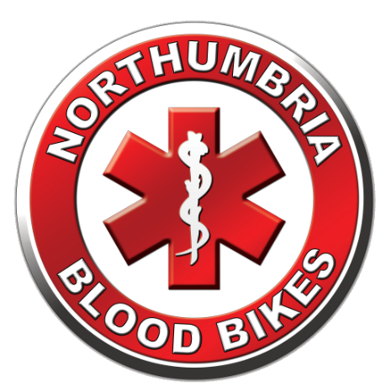
Northumbria Blood Bikes
Notes:
Hello My Name Is
I’m a Rider / Driver / Volunteer with Northumbria Blood Bikes
Thanks for the opportunity to share our story with you
Straw Poll – “how many of you have heard of us or know what we do”

Slide 2
A Quiz … Imagine it is ‘out of hours’, a patient urgently requires a blood transfusion but the hospital has run out of the specific blood type required. Who do they call?
Place in order of preference
Which is the odd one out?
1
2
A – NHSBT
B - Ambulance
3
4
C – TAXI
D – Blood Bike
Notes:
This slide demonstrates how the NHS is not as “Joined up” as you might think.
Set the scene –
embellish “a patient” with “someone you love”
Explain that there are 8 main blood types and each hospital has a limited supply of each type and can easily run out in the case of a serious trauma or having more than one emergency at a time (Road traffic collision?)
Ask the audience to put the four possible supply routes in order, either in thir heads or shout it out.
Reveal the answers
Most people get bloodbike – that’s why we’re there
Most groups are surprised that taxi is the next choice, explain that it is a common occurrence to use taxis especially before we came along) but that it costs money and there is no service guarantee.
NHSBT do have a 24hr delivery service, however the charges are determined nationally and we believe it is around £150 per delivery
Ambulances have never been used to ferry equipment for hospitals, they are under enough stress dealing with the demand from patients.
Now ask for an odd one out
Bloodbikes are the odd one out. NHSBT and NEAS are fully funded by the NHS, Taxi firms obviously do it commercially – we are the only provider who do it for free run completely y volunteers.

Slide 3
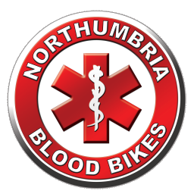

Who are we? What do we do?
NORTHUMBRIA BLOODBIKES
We are a local charity .
We provide an out of hours emergency courier service to North East hospitals and healthcare sites
We are independent of the NHS although we provide a service to them.
Charity Commission Registration
“To advance health or save lives, primarily in Northumbria, by providing a volunteer courier service ancillary to transport provided by the statutory authorities for the transfer of blood, blood products and other medical resources between hospitals and medical facilities."
Notes:
We are a charity.
When NHS couriers go home, hospitals used to rely on taxis or couriers to move urgent items out of hours.
We are not part of the NHS, or Blood Transfusion Service, but an independent charity.
Our charitable aim is to improve health and save lives.

Slide 4
Background & History Blood Bikes
NORTHUMBRIA BLOODBIKES
Blood Bike groups have existed for 60+ years
Volunteer led, free out-of-hours service carrying blood, blood products and other urgent items
2009: Nationwide Association of Blood Bikes (NABB) established
2013: 22 blood bike groups carried out 25,000 jobs across UK
2019: 36 blood bike groups carried out 100,000+ jobs across UK
2021: 36 independent Blood Bike groups (NABB Members) plus a handful of others now covering almost all of the UK
Notes:
Only the North West of Scotland is not covered.
A group has formed in Aberdeen to cover the NE of Scotland
Of the ? groups that are not members of NABB, many are working towards the standards required for membership
In recent years NBB has carried out 13,000 jobs on average, that about 1 in 7 of all jobs nationally.
Queen’s award for voluntary service is regarded as the MBE for charities it is open to local charities who have existed for 3 years or more deemed to enhance their local communities. Our view is that we are, of course, delighted to receive the award it recognises the importance of the service we provide as well as the professionalism and dedication of our volunteers

Slide 5
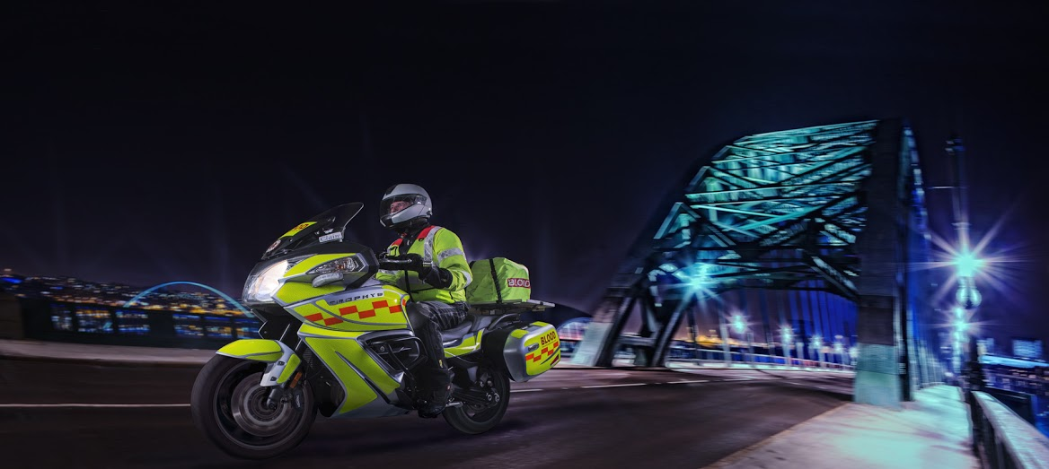

Background & History NBB
NORTHUMBRIA BLOODBIKES
2012: Northumbria Blood Bikes formed in September
2014: NBB began live operations in February
2017: NBB received Queen’s Award for Voluntary Service
2019: NBB Won the 1st ever “Volunteer of the Year” award from Newcastle Hospitals.
2021: NBB now performing an average of 13,000+ deliveries per year (over the last 5 years).
Notes:
In 2021 (or 2019) NBB carried out around 13300 jobs - 13% of the national total of 100,000 that’s about 1 in 7 jobs From 1 in 36 groups
Queen’s award for voluntary service is regarded as the MBE for charities it is open to local charities who have existed for 3 years or more deemed to enhance their local communities. Our view is that we are, of course, delighted to receive the award it recognises the importance of the service we provide as well as the professionalism and dedication of our volunteers
Winning the “Volunteer of the Year at Newcastle Hospitals shows that the NHS Trusts value the work we do. This was the first time Newcastle Hospitals have had such an award so we were up against the likes of the Royal Volunteer Service (previously WRVS) and Daft as a Brush (to name just two) so we were especially proud that the staff and the management recognised the work we do.

Slide 6
What do we do?
NORTHUMBRIA BLOODBIKES
We deliver urgent Blood, Platelets, Specimens, Meds, Equipment.
We recruit, train, and motivate volunteers to work with us
We run a fleet of around 20 vehicles
We organise fundraising and awareness events, and solicit donations, sponsorship and publicity from.. Anywhere and Anyone!
We do our own publicity: Newsletters, radio & TV interviews, banners, posters, promotional items, talks & presentations
We negotiate with Health Trusts, NEAS, NHSBT, GNAAS.
We are accountable; we record statistics, legal administration, evidence-backed with receipts, activity logs & recordings.
Notes:
Delivering to hospitals is the visible part of our service, our equivalent of a duck on the lake
Everything else is what it takes to enable the delivery service – paddling like mad under the water.

Slide 7
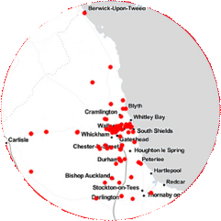
Our Coverage:
NORTHUMBRIA BLOODBIKES
We cover 7pm to 7am, every day, 365 days per year.
We also work around the clock on weekends & public holidays
We cover Northumberland, Tyne & Wear, County Durham and Darlington.
From Berwick to Darlington & DTV thru Barnard Castle, & Hexham to Sunderland and North Tyneside
We cover 7pm to 7am, every day, 365 days per year.
We also work around the clock on weekends & public holidays
We cover Northumberland, Tyne & Wear, County Durham and Darlington.
From Berwick to Darlington & DTV thru Barnard Castle, & Hexham to Sunderland and North Tyneside.
Notes:
The map outlines our region
It is more or less the medieval kingdom of Northumbria. (Originally it included North Yorkshire hence “North of the Humber Area”)
We can do relay runs with neighbouring groups.
We have serviced over 80 locations in the region

Slide 8
Our Funding:
NORTHUMBRIA BLOODBIKES
Our service is completely free of charge to the NHS
Nobody takes a salary..... every member works for free.
Funded wholly by donations from the general public, sponsorship & events. No government or NHS contribution.
Hundreds of Thousands of £££s saved in taxi & courier costs - which can be re-invested into patient care, equipment, extra nurses etc.
Running Costs are currently around £12,000 per month over half of which is the cost of fuel.
Notes:
We are led to believe that just one of the Trusts in the North East saved over £50,000 in a financial year as a result of NBB.
While corporate and large donors are happy enough to fund major capital items like vehicles, it is much harder to get funding for “running costs” as donors find it hard to see “what they get for their money”. We still, therefore, run hundreds (literally) of “tin – rattling” events collecting small donations to cover our running costs. After one busy bank holiday weekend our cashier had 35Kg of cash to take to the bank (that’s the equivalent of 35 bags of sugar).
We have no gender pay gap, the women get nowt the same as the men

Slide 9
Why use Motorbikes?
NORTHUMBRIA BLOODBIKES
Good for negotiating traffic congestion due to filtering ability
Riders can use "No Car" lanes
Motorcycles provide better fuel economy, reducing costs.
We promote the positive image of motorcycling, hopefully changing people’s perceptions and allowing them to see riders in a more positive light.
Through our rigorous training requirements, we are putting safer riders onto the roads, with hundreds of riders having taken advanced rider training and slow riding technique training. Every rider has an annual riding assessment.
However, we use cars too: When ambient temperature falls below 3º C regulations prohibit carriage of whole blood by motorcycle. We also use cars/vans for carrying equipment and towing our trailers and cars are now seamlessly integrated into our operations.
Notes:
Filtering is legal in the UK We can use “no Car” or Bus lanes except in Gateshead who don’t/won’t allow it. In Newcastle we have dispensation for our cars to use the No-Car lanes in Emergencies
We have a scheme to allow riders subsidised access to rider airvests to further improve their safety – unlike the BB uniform riders are able to use the airvest when riding their own bikes.
Our car fleet is now completely integrated into operations and we make no distinctions about their use, despite the charity still being called Northumbria Blood Bikes.

Slide 10

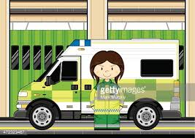

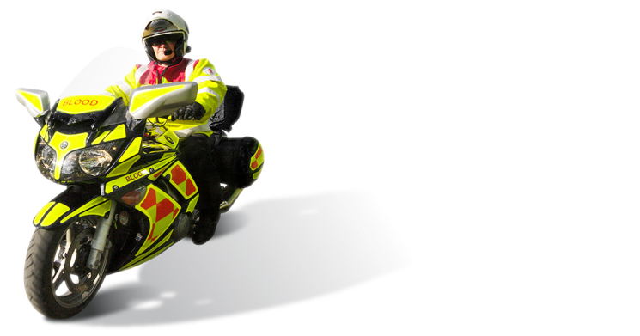
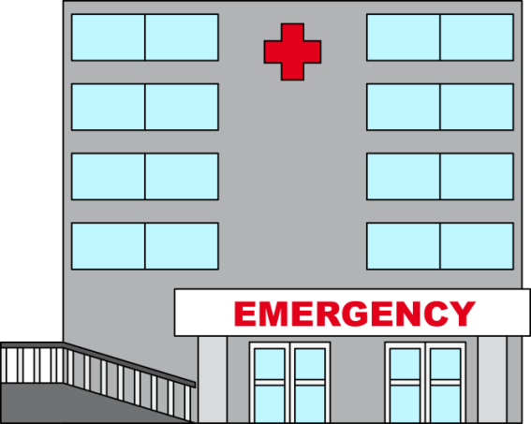
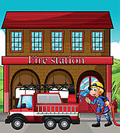
How It Works – Rider and Driver
NORTHUMBRIA BLOODBIKES
How it works:
Our vehicles are based around the region.
Mostly at Ambulance and Fire stations.
A member will have booked a shift in advance and chosen a vehicle to use.
Rider drives his own vehicle to the base hosting the vehicle for his shift.
Rider checks over the blood bike ready for the shift to start.
If the base station has a crew room, the rider can wait there for a callout.
Otherwise they may return home and wait there for a callout.
Alternatively they may wait for a callout at one of the hospitals.

Slide 11



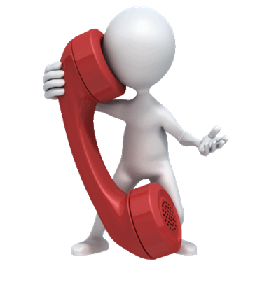
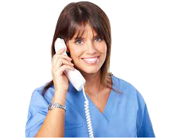

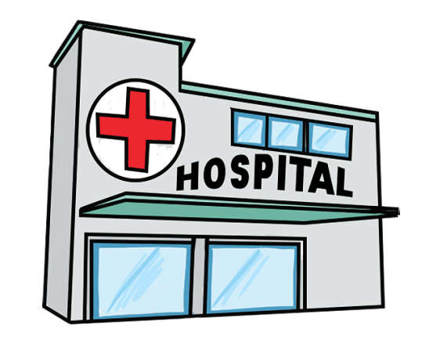

How it Works – Shift Controller
NORTHUMBRIA BLOODBIKES
How it works:
0191 228 6495
We have a “virtual number” in the cloud for hospitals to call us.
Our volunteers can redirect the number to their home phone.
Hospitals call our ‘hotline’ number, our volunteer gets the call.
We take the details of the job, and pass them to a rider / driver.
Rider / Driver collects and delivers the package keeping controller informed.

Slide 12
Operating Methodology:
NORTHUMBRIA BLOODBIKES
Members all carry photo I.D.
All have an advanced riding or driving qualification
Riding / Driving is assessed annually
All receive GMP Blood Handling training
Members use dedicated, liveried, vehicles - not their own.
Tracking devices fitted to all vehicles which alert on speed infringements, or alert shift controller of any problems.
Employer & Public liability insurances in place
Paid for by NBB fundraising, no formal NHS contribution.

Slide 13
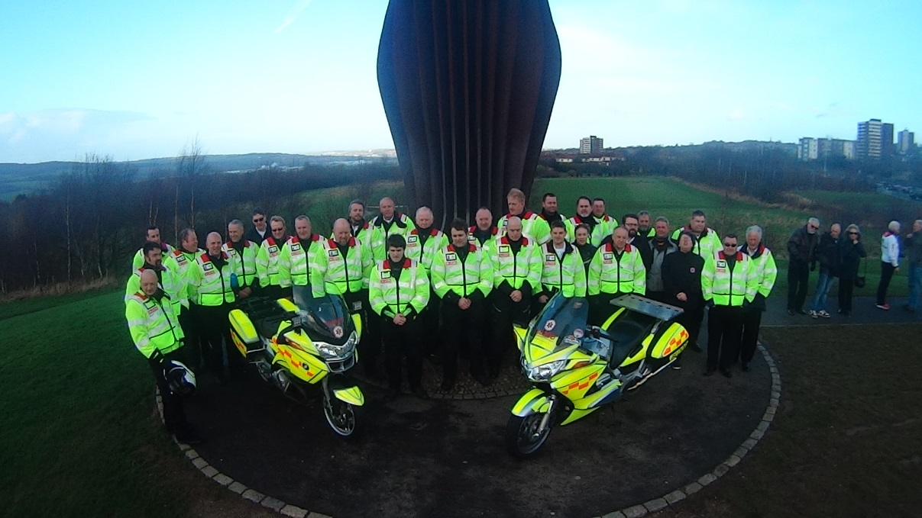
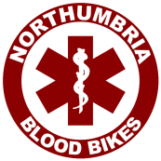
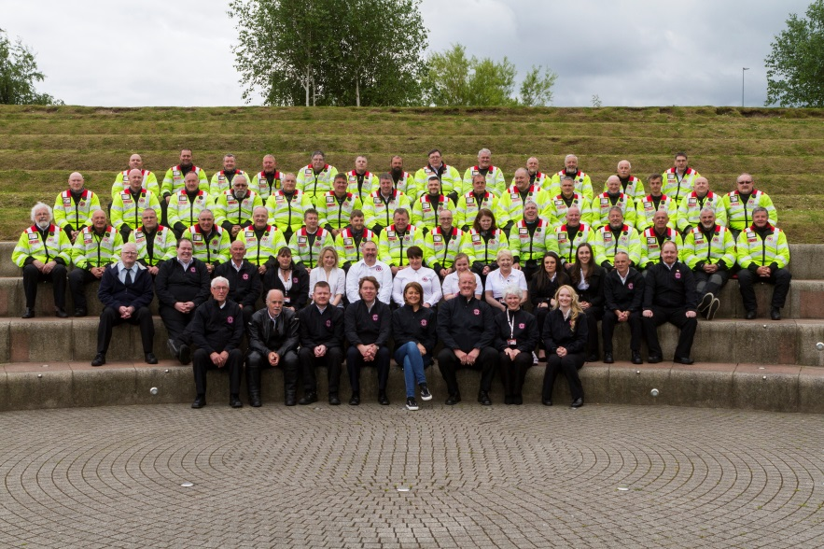
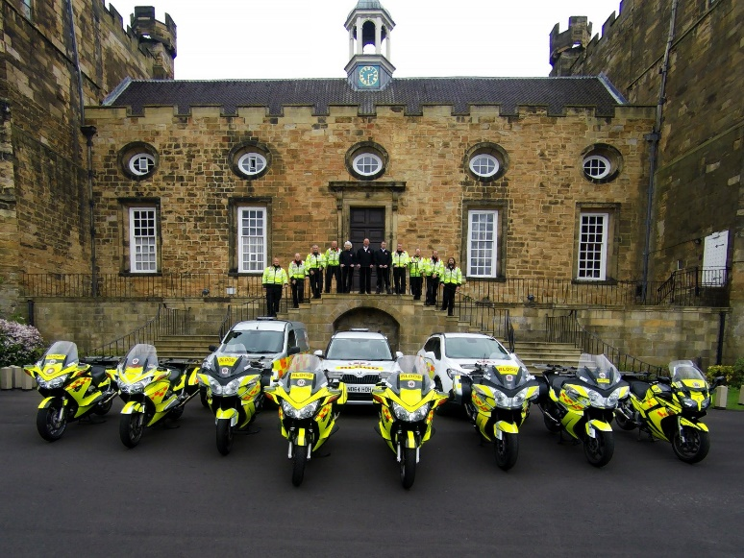
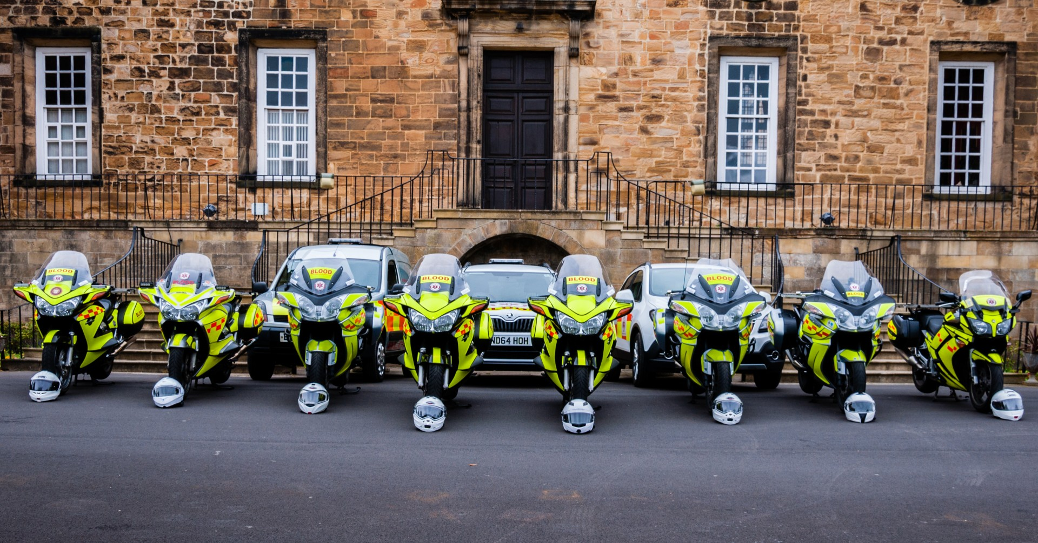



Photos Then and Now
Angel of the North Gateshead.
Sunday 2nd February 2014
(The day before we launched)
Registered Charity no. 1166689
www.northumbriabloodbikes.org.uk
Notes:
At the time of the photo (Feb 2014) this represented the complete fleet of vehicles - 2 motorcycles
there are 31 people in the photo (plus two taking photos) that represented about 90% of the membership at the time
We refresh our group portraits regularly
You can see the fleet has grown considerably but even that photo now needs updated
The volunteers photo was taken early summer 2017 and we had around sixty people at the photoshoot – only now it represented just over 10% of the group.
While Carol Malia (Front and Centre) did wear her NBB fleece on the day – she clearly didn’t get the message about black trousers being part of the uniform☺

Slide 14
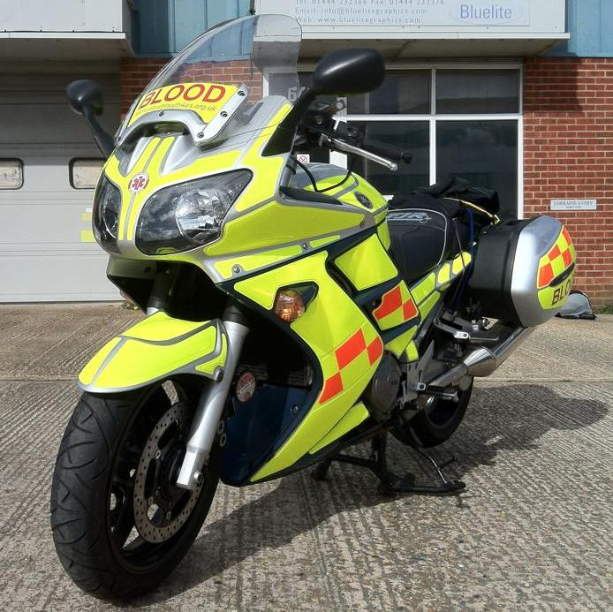
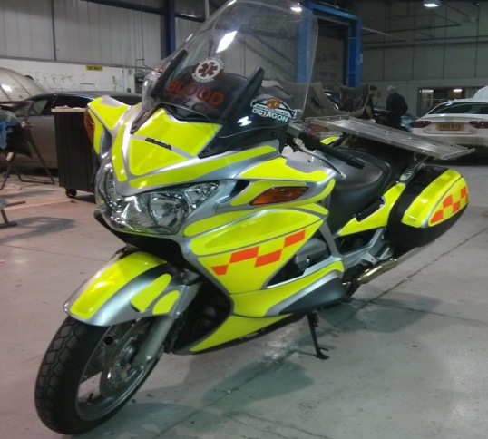
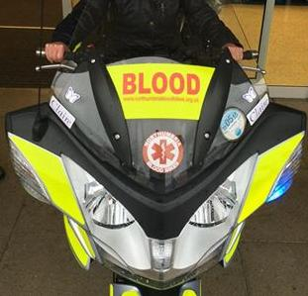
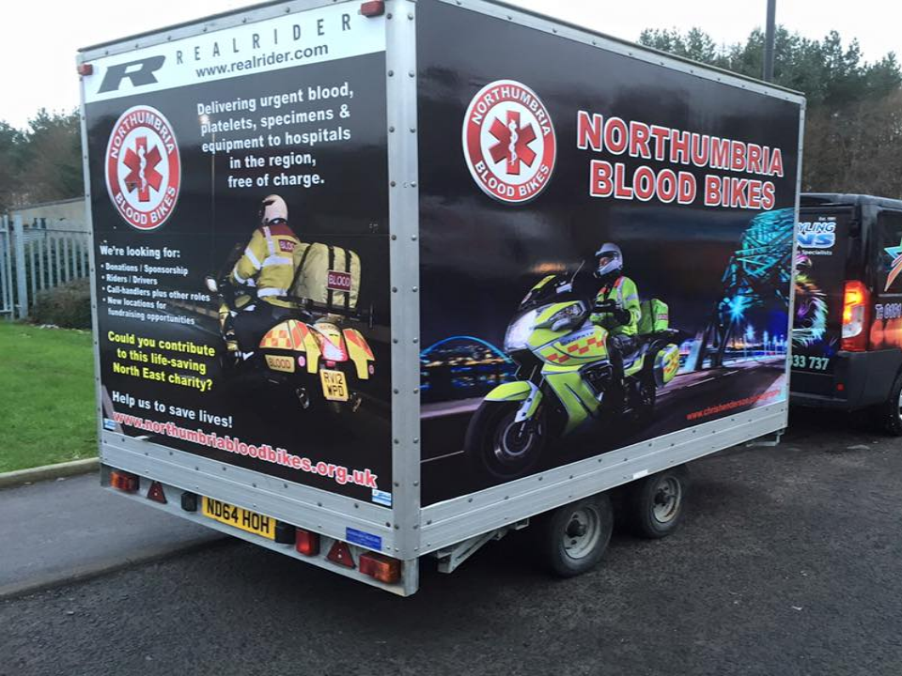
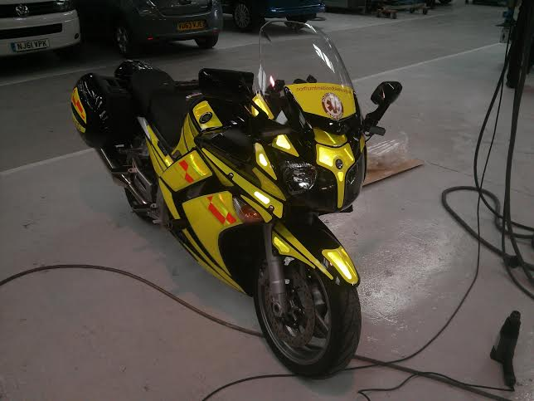
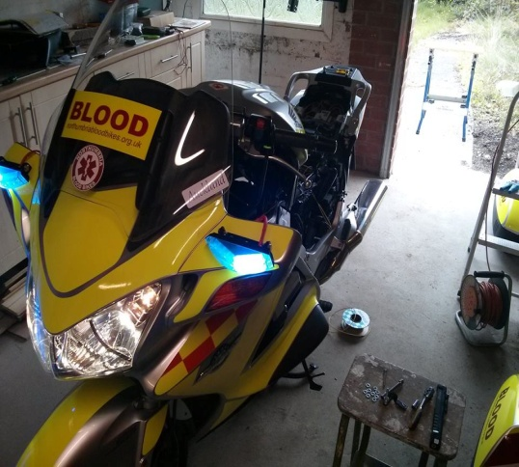
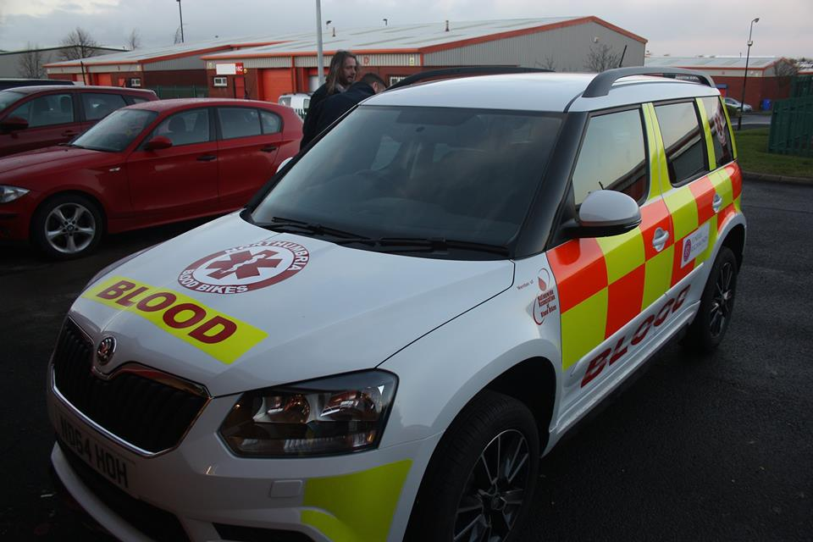
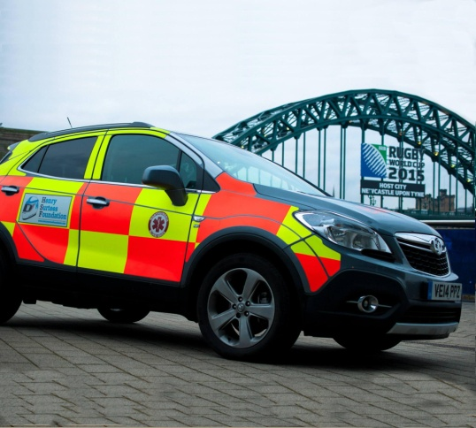
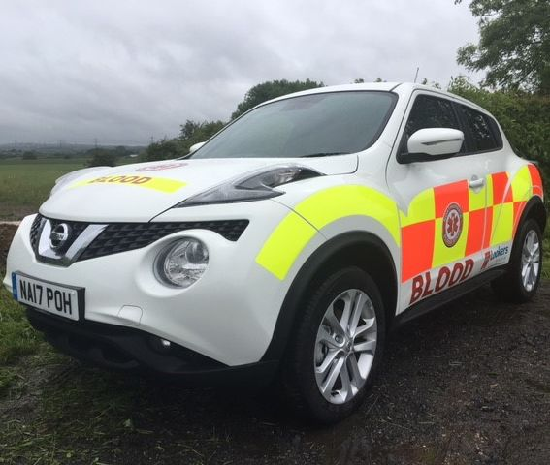
Our Vehicle Fleet:
NORTHUMBRIA BLOODBIKES
6 x Yamaha FJR
2 x Honda ST1300 Pan European
2 x BMW RT12x0
2 x BMW F800GT .
2 x Skoda Yeti
1 x Nissan Juke
3 x Skoda Octavia
1 x Exhibition trailer.
Notes:
Use big bikes for rider weather protection, rider visibility and load carrying capacity.
BMW F800s are slightly smaller to encourage shorter riders and lady riders to join
A number of our cars have automatic gearboxes to improve inclusivity

Slide 15
Membership:
NORTHUMBRIA BLOODBIKES
Over 300 Members in total.
Around 110 fully qualified riders
Around 103 fully qualified drivers
Approx. 50 people both ride and drive
Around 50 Shift Controllers.
Around 50 active Fundraisers.
Notes:
Numbers correct in Oct 2021
Analysis shows that around 50% of membership are “Active” in any given period
NABB reports 3,300 volunteers nationally in 2019 so NBB represent about 10% or 1 in 10

Slide 16
Some Stats
NORTHUMBRIA BLOODBIKES
13,308 packages delivered in 2020
Aug 18 was our busiest ever month – 1,300 jobs
75,000 jobs in total to September 2021
We now do more jobs every month than we did in the whole of our first year.
Notes:
Pick your favourite stats
13,000 per year = approx. 40 packages per day – or at least 40 people everyday whose healthcare is improved by what we do. (many packages contain more than one item)
You could compare that to the number of people in the room
We grew quickly to start but seem to have reached a plateau at around 1250 packages per month – that’s more than we did in our first year!
Average jobs per year over the last 5 years is around 13,300 or 1 in 7 of all jobs done nationally.
Figures for 2021 are an estimate in Nov 21
Reduction in 2020 /2021 represents 5% drop – probably due to reduced numbers of patients arriving in A&E or regular clinics not being completely balanced out by increase in covid activity???

Slide 17
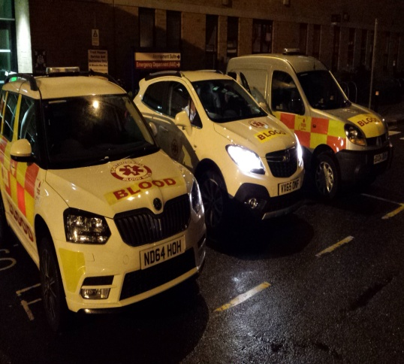
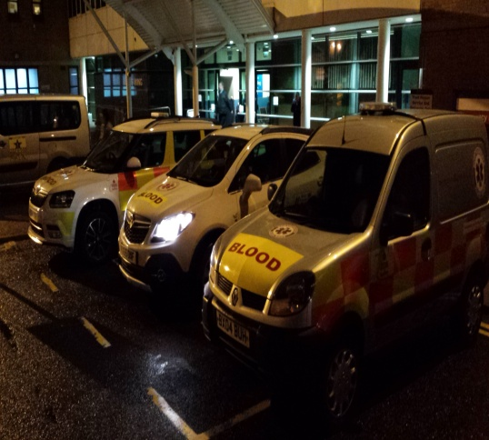
Highlights
NORTHUMBRIA BLOODBIKES
Now operating up to 5 vehicles each shift
Jobs from outlying areas (Berwick / Alnwick and Barnard Castle) now becoming much more common.
We also perform a number of Long-Distance Relays with other groups
June 2017 we received the Queen’s Award for Voluntary Service.
Notes:
We are doing jobs much farther afield as our service and reputation grows. This puts more stress on the duty riders / drivers as jobs can take much longer. Controllers also have to “box clever” to ensure that the “Newcastle Shuttle” (RVI / Freeman / NHSBT) is covered and all vehicles are not scattered far and wide.
We have been involved in a series of long distance relays including: A weekly run for several weeks of samples from Chesterfield Royal Hospital which needed to be tested at the Freeman as it was the only hospital capable of doing the tests. (reading between the lines this might have been a heart transplant patient) We relayed with Cumbria >> North West Lakes and Lancs
A series of runs from Northumberland to the Human Milk Bank in Chester- this was a lady in Northumberland who lost a very young baby and continued to express milk which was frozen and taken to the Milk Bank in Chester. (There is no Human Milk Bank in the North East) We relayed with White Knights (Yorkshire) >> Derbyshire.
We know of a long distance relay from Liverpool to Newcastle which was sent by taxi by mistake cost the trust involved around £250.

Slide 18
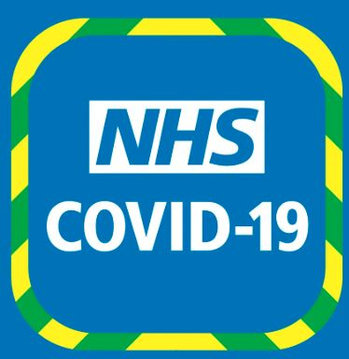
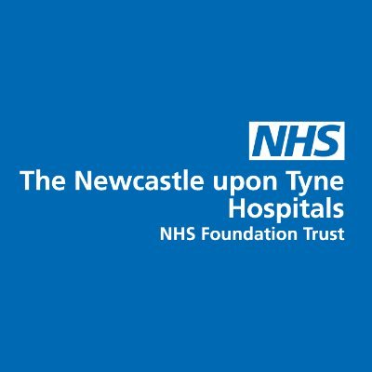
NBB and Covid Pandemic
NORTHUMBRIA BLOODBIKES
We have continued to operate as normal throughout the pandemic.
Newcastle hospitals asked us to provide daytime coverage too.
Regular scheduled runs of Covid samples between laboratories
Delivery of medication
Lockdown meant fundraising was hit badly
Recruitment and Training also affected – many tasks moved on-line.
Notes:
Our service continued to all trusts throughout the pandemic. We have changed our protocols to include face masks and improved cleaning where appropriate.
Newcastle hospitals approached us to increase our service to them,
regular, scheduled shuttle runs between hospital laboratories This included throughout the day.
We also provided daytime volunteer drives for other covid related activities such as deliveries of medications to care homes.
As events and meetings were cancelled during lockdown, our fundraising activities were severely hit. We were fortunate to benefit from charitable grants and subsidised fuel from BP during the pandemic which means our financial reserves have not taken too much of a hit.
As we were unable to meet up during lockdown our rider/driver training and assessment activities were severely restricted which had a knock-on effect to our recruitment of volunteers. As restrictions are eased we are slowly getting back to normal, although we have adapted some activities so thy can be carrid out on-line

Slide 19
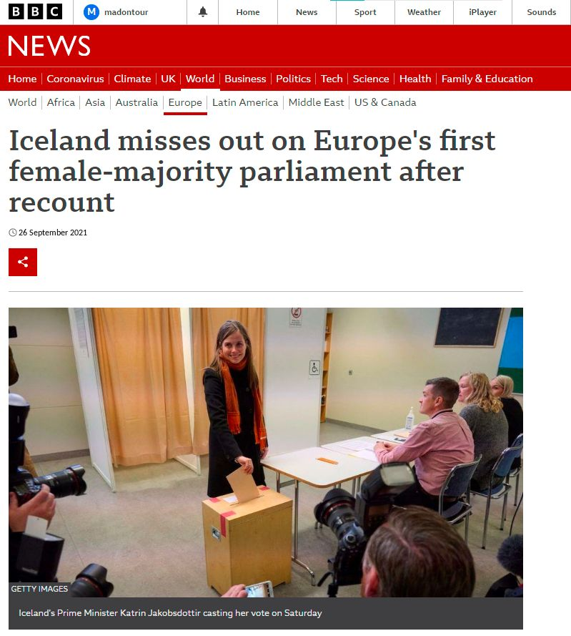
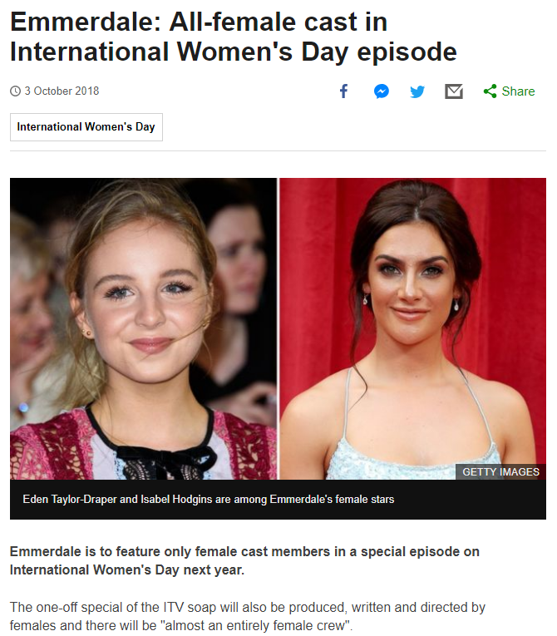
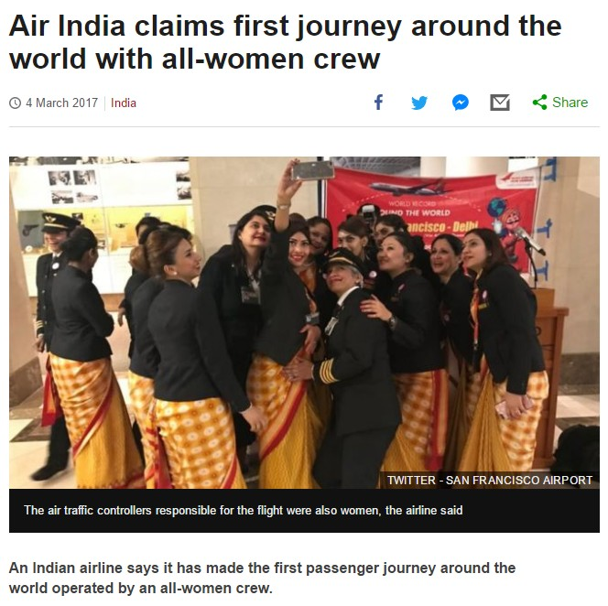
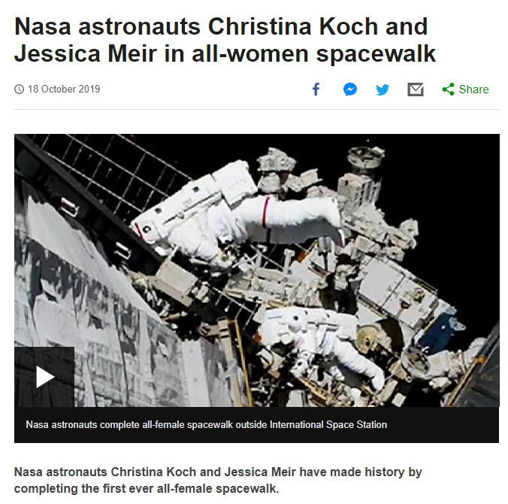
Notes:
Highlighting our all-female shift on boxing day 2015 to demonstrate our diversity and that there are roles in our group for everybody. We can claim that even national airlines, national treasures (Emmerdales) and inter-galactic space travellers (NASA) are copying our ideas and show the publicity / news items.
We could mention our smaller bikes and automatic cars as further evidence of our strive for inclusivity and diversity.

Slide 20
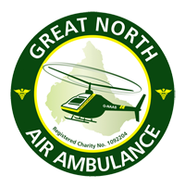
Blood On Board (“BoB”)
NORTHUMBRIA BLOODBIKES
"The daily delivery of blood to each of the two Great North Air Ambulance helicopters, to enable blood transfusions at the scene of an accident instead of waiting until the patient reaches a hospital"
Idea came from frontline military field hospitals in Afghanistan
Only group "O negative" blood used - can be given to any patient
Specially insulated storage boxes maintain temperature for 48 hours
In-built electronics show if box temperature has breached thresholds
Blood transfused at scene is heated to body temperature "on the fly"
Unused blood is returned to hospitals before it deteriorates, so that it can go back into circulation for use in operations: No waste!
Relay with another blood bike group to reach the furthest base in Penrith

Slide 21
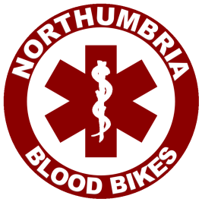
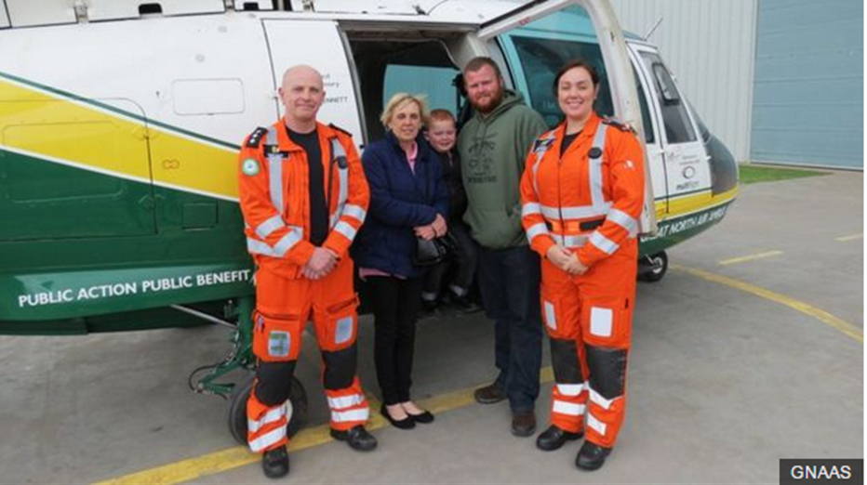
Blood On Board (“BoB”)
NORTHUMBRIA BLOODBIKES
NORTHUMBRIA BLOODBIKES
An update on the BoB project from GNAAS:
1st used within 24hrs of launch in Jan 2015.
Over 200 ‘on scene’ transfusions
Thousands of cool boxes delivered & collected by blood bikes
So successful, scheme has expanded to include a HEMS car and daytime replenishment of blood by NBB when required.
28+ “unexpected survivors” directly attributed to BoB scheme.
Notes:
Update August 2018– latest figures not yet received from GNAAS
At least 28 lives have been saved as a result of air ambulances carrying blood on board, the charity has said averaging one per month.
The Great North Air Ambulance Service (GNAAS), which covers the North East, Cumbria and North Yorkshire, started the scheme in January 2015. We can generalise to say one “unexpected survivor” per month.
Since then, medics have performed hundreds of transfusions, a third of which were deemed to have been of critical importance to survival. Many others have had their outcomes improved by having the intervention. GNAAS now run a HEMS (Helicopter Emergency Medical Service) car service in our city centres on Friday and Saturday nights which will soon be extended to operate weekend days too. NBB now replenish the HEMS car or Helicopter (if required) during daytime.
--------------------------------------------------------------------------------------------------------------
As part of their 15th Anniversary celebrations GNAAS highlighted 15 memorable patients – including Logan Murdoch a FOUR-year-old boy who was ‘internally decapitated’ and not expected to survive the same horrific road crash which killed his mother and great-grandmother
Logan Murdoch, from Carlisle, was left fighting for his life after a serious traffic collision on the A595 at Newby Cross. His mother, and great-grandmother, died in the incident, when their car collided with a van on February 23, 2016. Logan suffered an internal decapitation, which is a separation of the spinal column from the base of the skull, as well as brain injuries, a punctured lung and a broken collar bone. He was not breathing when the GNAAS crew arrived at the incident. Logan was resuscitated at the roadside before being put into a medically-induced coma by the GNAAS doctor-led trauma team. He was also given blood en route to the Royal Victoria Infirmary in Newcastle.
GNAAS - Dr Duffy said: “Logan was one of our ‘unexpected survivors.’ That means that statistically, with the injuries he sustained, he was unlikely to survive.”

Slide 22
Blood On Board (“BoB”)
NORTHUMBRIA BLOODBIKES
"The Great North Air Ambulance Service relies entirely on the Blood Bikes charity to deliver blood products to our two air bases in the North East and North West of England. The service they provide is extremely professional, reliable and without their service we would be unable to provide pre-hospital blood transfusions at the roadside to critically injured patients. Blood Bikes was the only organisation capable of meeting our needs and we have been impressed with every aspect of their service, from the training and qualifications of their riders, to the flexibility and “can do” attitude of their team. We are aware that this service is dependent on external charitable funding and would sincerely encourage potential donors to support this life-saving organisation."
Dr David Bramley, MBChB, FRCS(A&E)Ed, FCEM, FIMC RCSEd
Medical Director, GREAT NORTH AIR AMBULANCE SERVICE
Notes:
Highlighted some key phrases

Slide 23
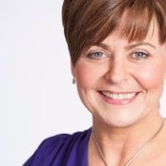
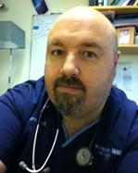
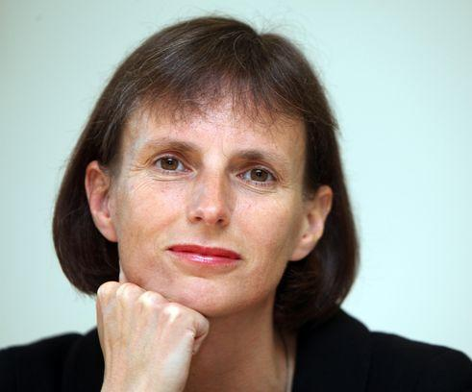
Patrons:
NORTHUMBRIA BLOODBIKES
Carol Malia BBC TV Presenter, Deputy Lord Lieutenant of Northumberland
Bob Jarman MBBS MSc FRCS(Ed) FCEM FRCP(Ed) CFEU Consultant in Emergency Medicine
Heidi Mottram OBE CEO, Northumbrian Water

Slide 24
Feedback:
NORTHUMBRIA BLOODBIKES
"We had a horrific ***** major haemorrhage a few weekends ago, the patient was issued over *** products by the lab which was a phenomenal amount of products to get out. I would really like to thank the blood bike staff who were working that day as their efforts in transporting blood products to the lab was fantastic. Without their amazing support we would not have been able to provide such a quick turnaround on our major haemorrhage boxes. If you can pass on our sincere thanks that would be great.”
Mail received from Senior Clinician, RVI Newcastle
Notes:
Feedback received from the RVI - some details redacted to aid anonymity for the patient Perhaps enhances our ability to say that our service saves lives

Slide 25
Feedback:
NORTHUMBRIA BLOODBIKES
“Northumbria Blood Bikes are a dedicated team of tightly knit volunteers working so professionally together. Their service has already saved many lives. The bikers and drivers undergo extensive training, all in their own time, and are supported by an efficient network of other volunteers all devoting themselves to supporting emergency health care. I have a personal reason to thank NBB. My friend’s son went into cardiac arrest after undiagnosed internal bleeding. At the age of 14 they found themselves at his bedside praying for his survival. He needed blood, and quickly. It was a Northumbria Blood Bike that delivered the consignment which ultimately meant that Matthew has made a complete recovery.”
Carol Malia, BBC TV Presenter, Deputy Lieutenant of Northumberland
Notes:
Feedback received from Carol Malia

Slide 26
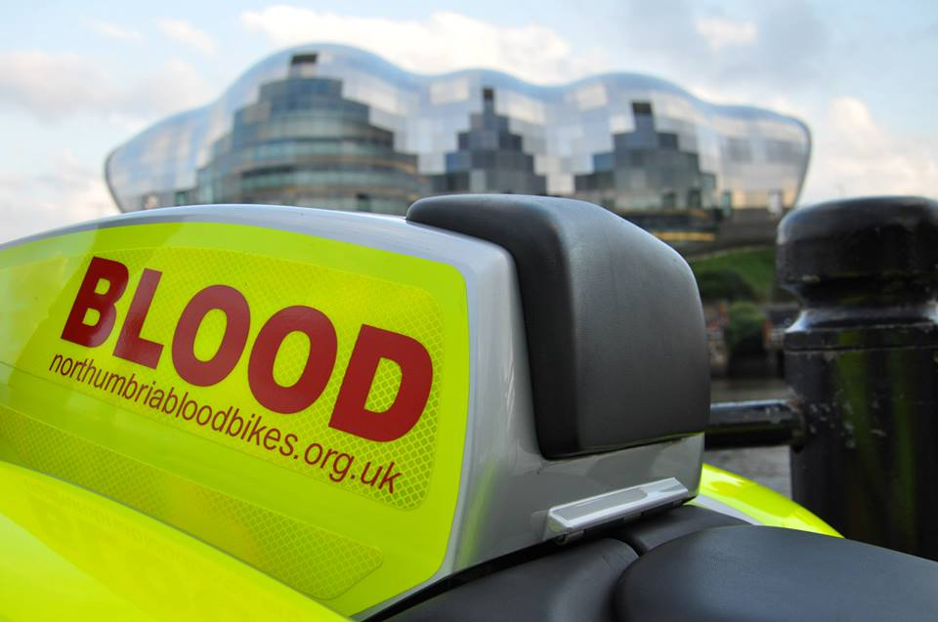




Closing Slide
Registered Charity no. 1166689
www.northumbriabloodbikes.org.uk

