Slide 1
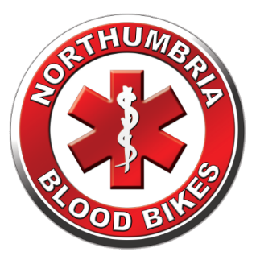
Northumbria Blood Bikes
Notes:
Hello My Name Is
I’m a Rider / Driver / Volunteer with Northumbria Blood Bikes
And on behalf of Northumbria Bloodbikes, thank you for the opportunity to share our story with you
Straw Poll – “how many of you have heard of us or know what we do”

Slide 2
A Quiz … Imagine it is ‘out of hours’, a patient urgently requires a blood transfusion but the hospital has run out of the specific blood type required. Who do they call?
Place in order of preference
Which is the odd one out?
1
2
A – NHSBT
B - Ambulance
3
4
C – TAXI
D – Blood Bike
Notes:
This slide demonstrates how the NHS is not as “Joined up” as you might think.
Set the scene –
embellish “a patient” with “someone you love”
Explain that there are 8 main blood types and each hospital has a limited supply of each type and can easily run out in the case of a serious trauma or having more than one emergency at a time (Road traffic collision?)
Ask the audience to put the four possible supply routes in order Reveal the answers
Most people get bloodbike – that’s why we’re there
Most groups are surprised that taxi is the next choice, explain that it is a common occurrence to use taxis especially before we came along) but that it costs money and there is no service guarantee.
NHSBT do have a 24hr delivery service, however the charges are determined nationally and we believe it is around £150 per delivery
Ambulances have never been used to ferry equipment for hospitals, they are under enough stress dealing with the demand from patients.
Now ask for an odd one out
Bloodbikes are the odd one out. NHSBT and NEAS are fully funded by the NHS, Taxi firms obviously do it commercially – we are the only provider who do it for free run completely volunteers.

Slide 3
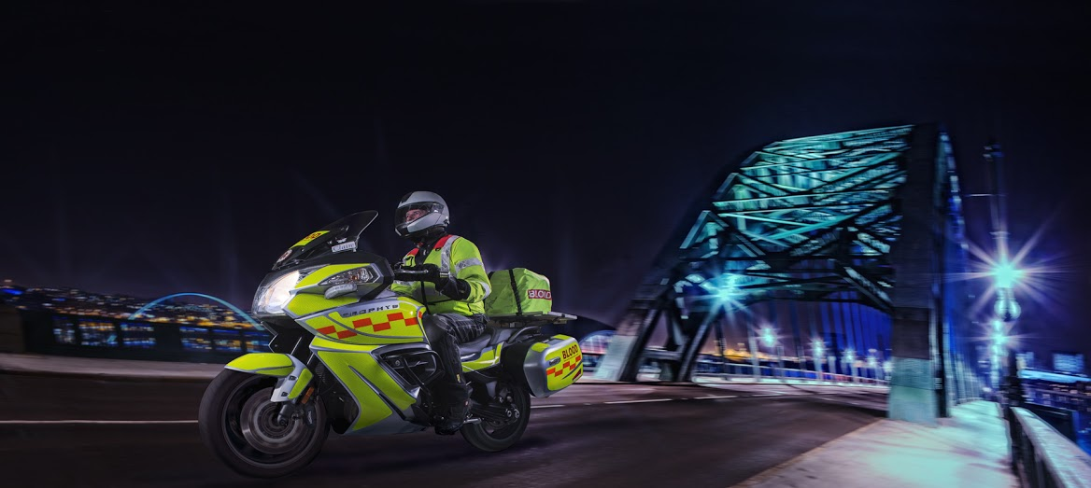
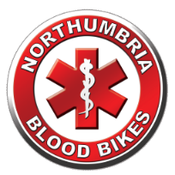

Who are we and what do we do ?
NORTHUMBRIA BLOODBIKES
We are a local charity
We provide an out of hours courier service to NHS hospitals and healthcare sites
We are independent of the NHS although we provide a service to them
Charity Commission Registration
“To advance health or save lives, primarily in Northumbria, by providing a volunteer courier service ancillary to transport provided by the statutory authorities for the transfer of blood, blood products and other medical resources between hospitals and medical facilities."
Notes:
We are a charity.
When NHS couriers go home, hospitals used to rely on taxis or couriers to move urgent items out of hours.
We are not part of the NHS, or Blood Transfusion Service, but an independent charity.
Our charitable aim is to improve health and save lives.
Queens award

Slide 4


Background & History
NORTHUMBRIA BLOODBIKES
1962 First Blood Bike volunteer group established in Surrey
2008: Nationwide Association of Blood Bikes (NABB) established
2012: Northumbria Blood Bikes formed
2014 : 22 Blood bike groups in operation and NBB goes live
2017: NBB received Queen’s Award for Voluntary Service
2021: Over 13,000 jobs completed, with almost 9000 Covid related
2023:
2024 : 13,200 jobs
Notes:
First group formed in 1962 in Surrey called Emergency Volunteer Service (EVS)
QA is highest award given to volunteer groups
Discuss milestone and how many taxi fares have been saved

Slide 5

What do we do?
NORTHUMBRIA BLOODBIKES
Transport blood, platelets, specimens, samples, notes, equipment and breast milk for the NHS
Recruit and train our volunteers & run our fleet of vehicles
Generate our publicity, organise our fundraising, talks and awareness events, solicit donations and sponsorship from.. Anywhere and anyone!
Negotiate with Health Trusts, NEAS, NHSBT, GNAAS.
We are accountable, recording statistics and legal administration, evidence-backed with receipts & records
Notes:
Delivering to hospitals is the visible part of our service, our equivalent of a duck on the lake
Everything else is what it takes to enable the delivery service – paddling like mad under the water.

Slide 6
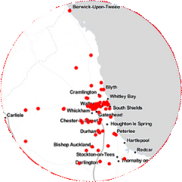
Our Coverage:
NORTHUMBRIA BLOODBIKES
We cover 7pm to 7am every day, 365 days per year.
Around the clock on weekends & public holidays
We cover over 100 locations in Northumberland, Tyne & Wear and County Durham
Notes:
More or less the medieval kingdom of Northumbria. (Originally it included North Yorkshire hence “North of the Humber Area”)
We can do relay runs with neighbouring groups.
We have serviced over 100 locations in the region

Slide 7
Our Funding:
NORTHUMBRIA BLOODBIKES
Service is completely free to the NHS
Our time is given for free
We receive no government or NHS contributions, we’re funded wholly by donations from the general public, sponsorship & events
Thousands of £££s in taxi & courier costs saved. Which can be invested into patient care, equipment, extra nurses etc
Running costs are over £12,000 per month - approx half of which is fuel
Notes:
We are led to believe that just one of the Trusts in the North East saved over £50,000 last financial year as a result of NBB.
While corporate and large donors are happy enough to fund major capital items like vehicles, it is much harder to get funding for “running costs” as donors find it hard to see “what they get for their money”. We still, therefore, run hundreds (literally) of “tin – rattling” events collecting small donations to cover our running costs. After one busy bank holiday weekend our cashier had 35Kg of cash to take to the bank (that’s the equivalent of 35 bags of sugar).

Slide 8
Why use Motorbikes?
NORTHUMBRIA BLOODBIKES
Good for negotiating traffic and filtering
Can use "No Car" lanes
Good fuel economy and reduced running costs
We promote the positive image of motorcycling
We also use cars; if ambient temperature falls below 3º C regulations prohibit carriage of blood by motorcycle. Cars and our van are an integral part of our service, transporting equipment
Notes:
Filtering is legal in the UK We can use “no Car” or Bus lanes except in Gateshead who don’t/won’t allow it. In Newcastle we have dispensation for our cars to use the No-Car lanes in Emergencies
Our car fleet is now completely integrated into operations and we make no distinctions about their use, despite the charity still being called Northumbria Blood Bikes.

Slide 9
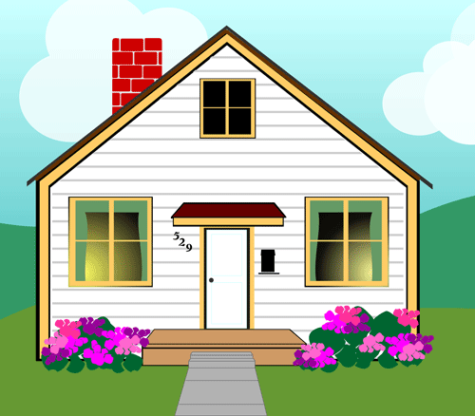
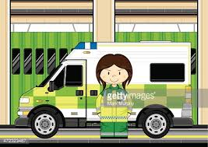

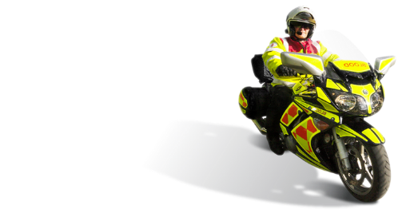
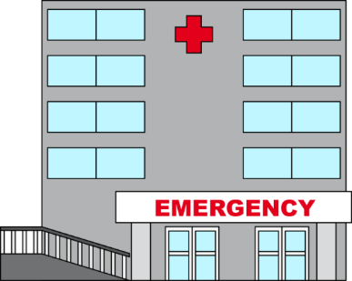
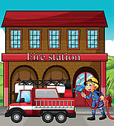
NORTHUMBRIA BLOODBIKES
How it works:
Our vehicles are based around the region.
Mostly at Ambulance and Fire stations.
A member will have booked a shift in advance and chosen a vehicle to use.
Rider drives his own vehicle to the base hosting the vehicle for his shift.
Rider checks over the blood bike ready for the shift to start.
If the base station has a crew room, the rider can wait there for a callout.
Otherwise they may return home and wait there for a callout.
Alternatively they may wait for a callout at one of the hospitals

Slide 10
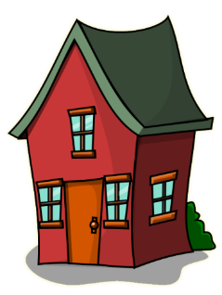


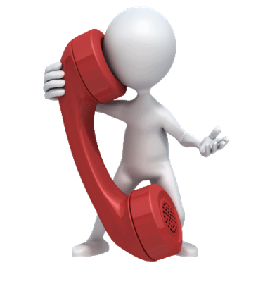

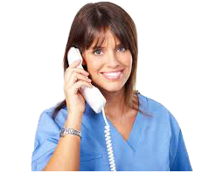
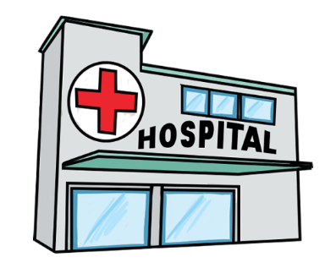
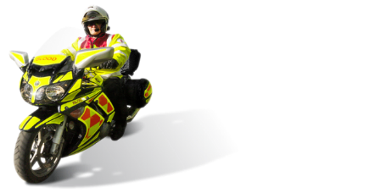
NORTHUMBRIA BLOODBIKES
How it works:
Hospitals can reach us through a “virtual number” that forwards calls to the volunteer controller’s home phone.
Hospitals or trusts call our ‘hotline’ number, our volunteer gets the call.
Job details are taken and passed to a rider / driver
Rider / driver collects and delivers the package keeping controller informed

Slide 11
Operating Methodology:
NORTHUMBRIA BLOODBIKES
Up to five vehicles per shift in operation
Members carry photo ID and wear a branded uniform
Dedicated, liveried vehicles – we don’t use our own
Riders / drivers hold an advanced riding or driving (or both) qualification – annually assessed
All receive GMP Blood Handling training
Vehicles have tracking devices and CCTV fitted
Defibrillators in some vehicles
All paid for by fundraising and donations
Notes:
Talk about volunteering
Request is for two shifts per month per volunteer
How we book shifts and different types of shift available
Different roles

Slide 12
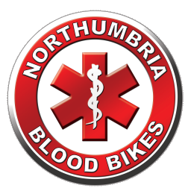
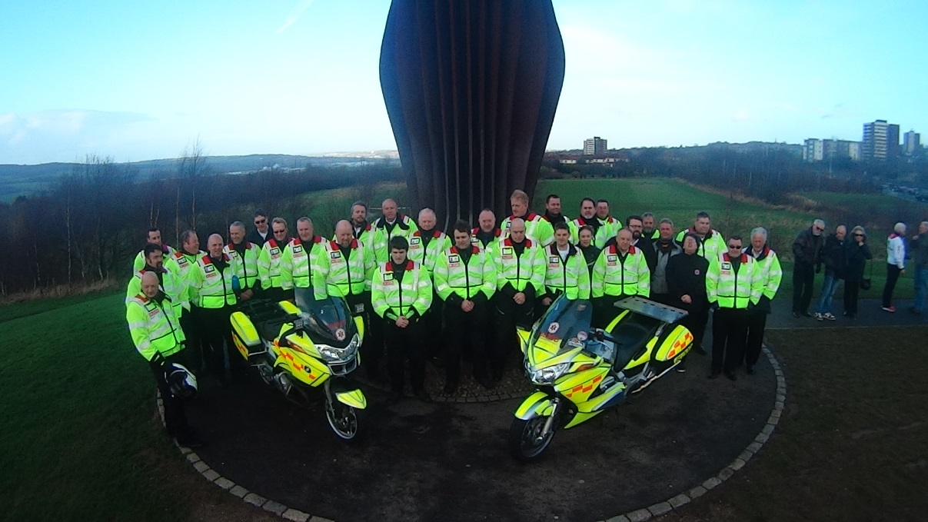
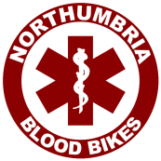
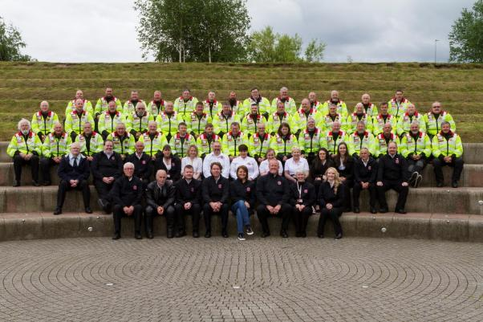
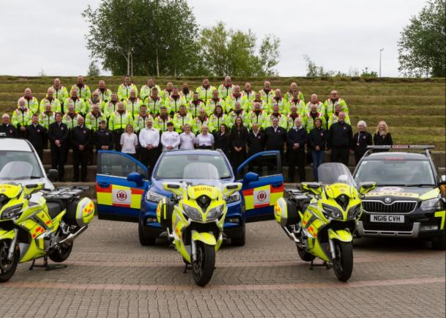
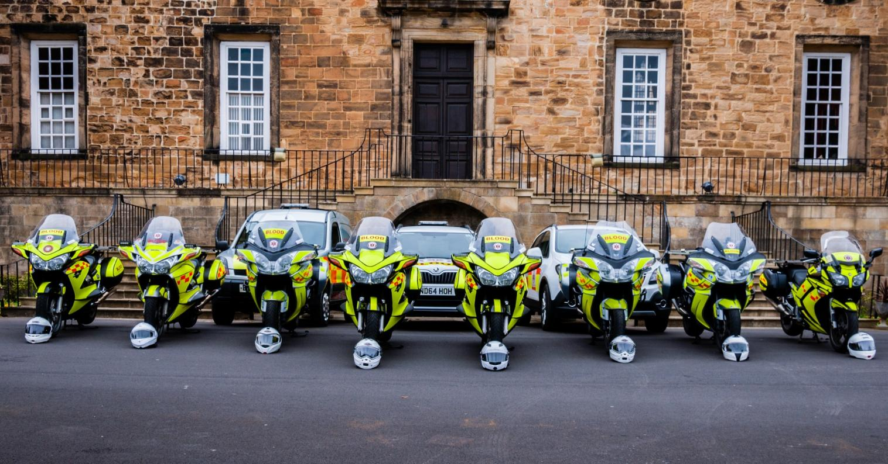



Photos Then and Now
Angel of the North Gateshead.
Sunday 2nd February 2014
(The day before we launched)
Registered Charity no. 1166689
Around 240 active members
112 Riders
124 Drivers
37 Fundraisers
44 Shift Controllers
www.northumbriabloodbikes.org.uk
Notes:
Feb 2014 this represented the complete fleet of vehicles - 2 motorcycles
there are 31 people in the photo (plus two taking photos) that represented about 90% of the membership at the time
You can see the fleet has grown considerably but even that photo (a year old) now needs updated
The volunteers photo was taken early summer 2017 and we had around sixty people at the photoshoot – only now it represented just over 10% of the group.
While Carol Malia (Front and Centre) did wear her NBB fleece on the day – she clearly didn’t get the message about black trousers being part of the uniform☺

Slide 13

NORTHUMBRIA BLOODBIKES
Our fleet
Yamaha FJR 1300
BMW R1250RT
BMW F800 GT
Skoda Octavia Scout
Skoda Yeti
Toyota Corolla Hybrid
Yaris Cross Hybrid
Volkswagen Transporter
Notes:
Touring style bikes used due to..
Load carrying ability
Weather protection
Cars are mostly 4 x 4
No full electric vehicles but we do run several Hybrids which are proving successful

Slide 14
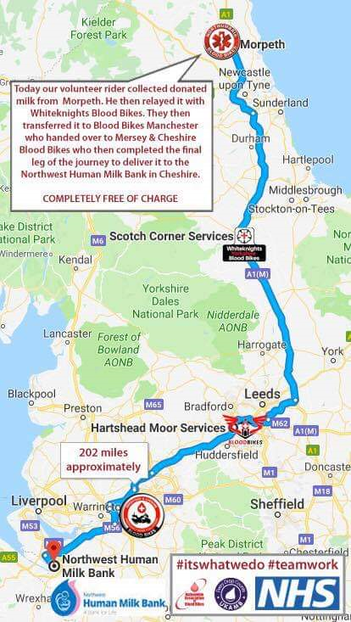
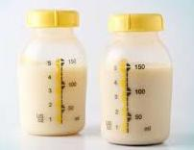
NORTHUMBRIA BLOODBIKES
Breast Milk relays
As part of a national network of blood bike groups, we help transport donated breast milk nationwide.
Morpeth to Northwest Human Milk Bank in Cheshire
Northumbria Blood Bikes
White Knights
Blood Bikes Manchester
Mersey & Cheshire Blood Bikes
Distance 202 miles
Notes:
A series of runs from Northumberland to the Human Milk Bank in Chester- this was a lady in Northumberland who lost a very young baby and continued to express milk which was frozen and taken to the Milk Bank in Chester. (There is no Human Milk Bank in the North East) We relayed with White Knights (Yorkshire) >> Derbyshire.
We know that a long distance relay from Liverpool to Newcastle which was sent by taxi by mistake cost the trust involved around £250.

Slide 15
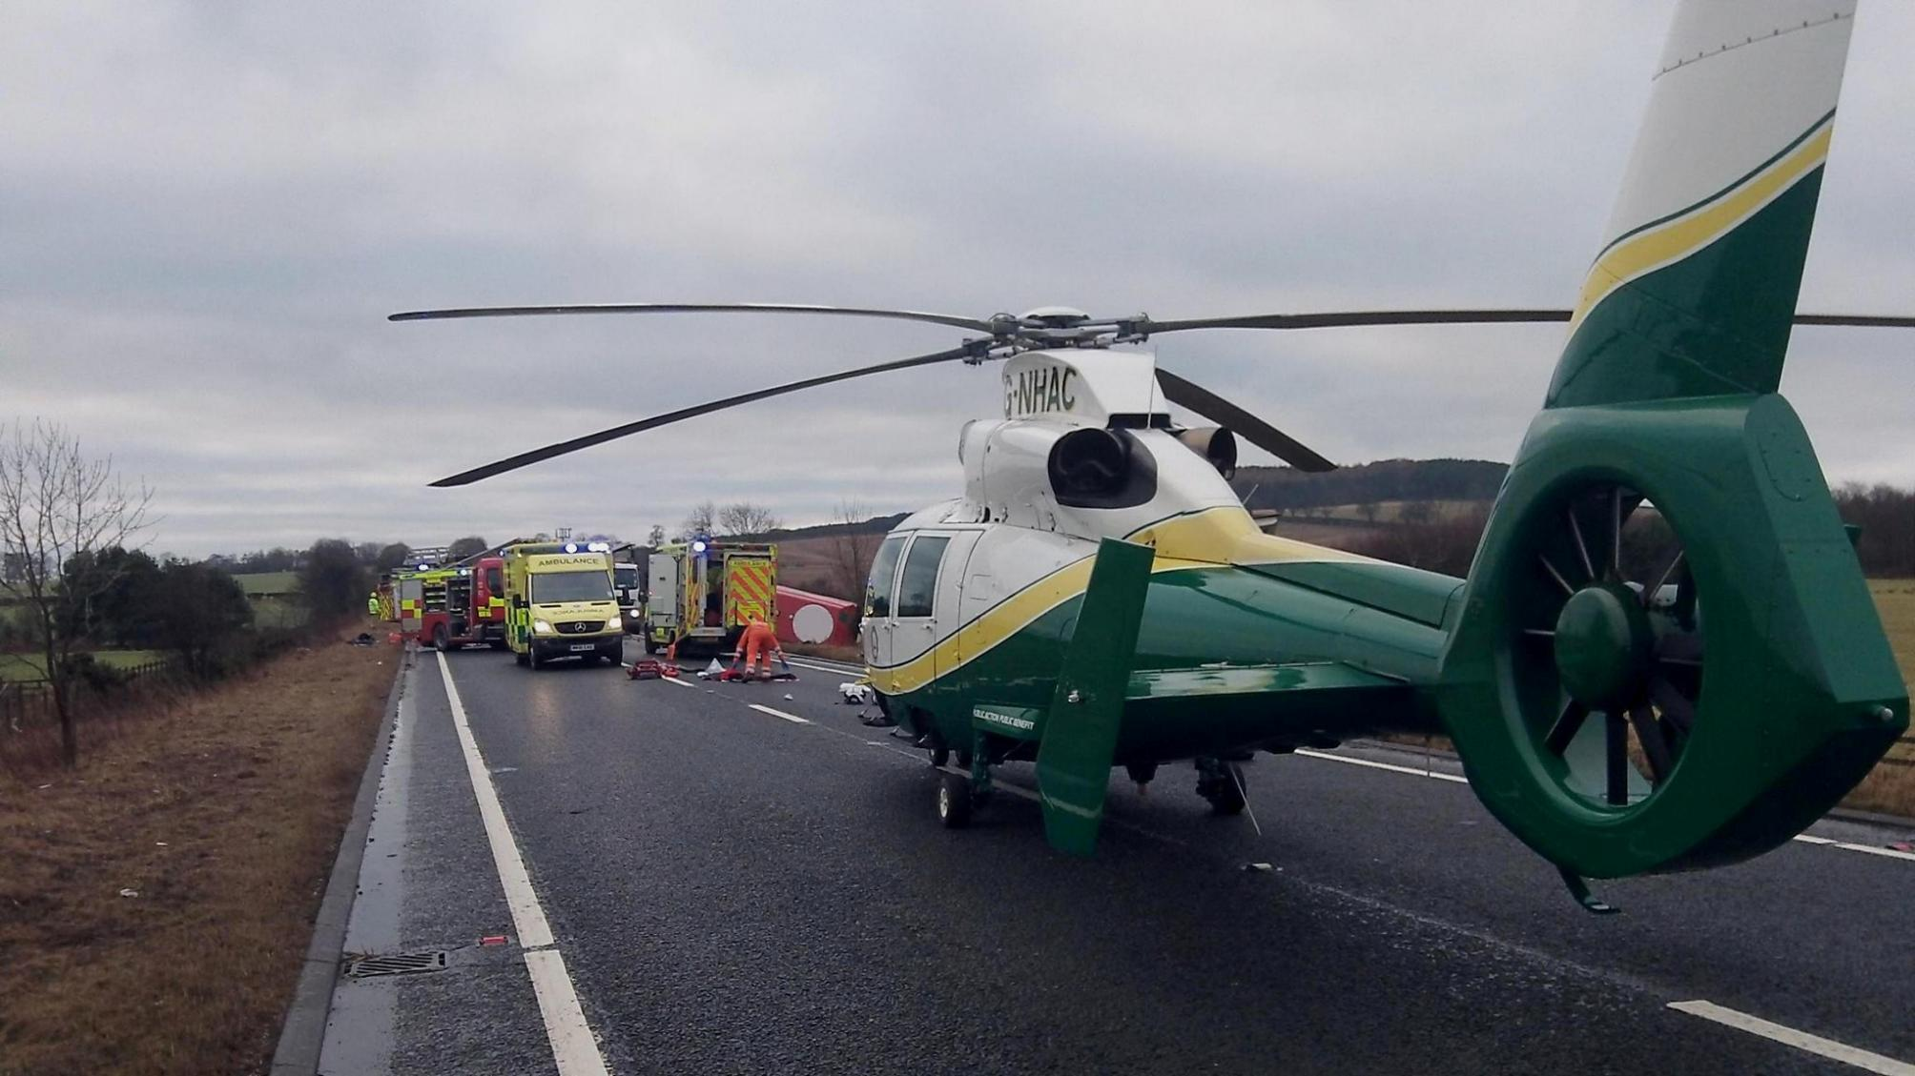
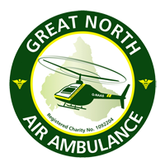
Blood On Board (“BoB”)
NORTHUMBRIA BLOODBIKES
Nightly delivery to both Great North Air Ambulance helicopters.
Enables transfusions at scene
Idea came from military operations in Afghanistan
"O negative" blood used – compatible with all blood types
Specially designed boxes maintain and monitor temperature for up to 48 hours
Transfused blood heated to body temperature on scene
Unused blood returned to hospitals & used in operations - No waste !
Notes:
Discuss each point

Slide 16
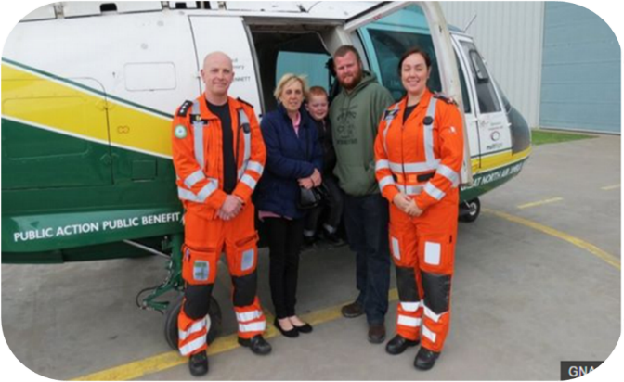
Blood On Board (“BoB”)
NORTHUMBRIA BLOODBIKES
Update from GNAAS
Used within 24hrs of launch in 2015
Around a third of transfusions contributed to survival
100% record on delivery, tracking and traceability
Scheme now expanded to HEMS car
Notes:
Unexpected survivors – Logans story

Slide 17
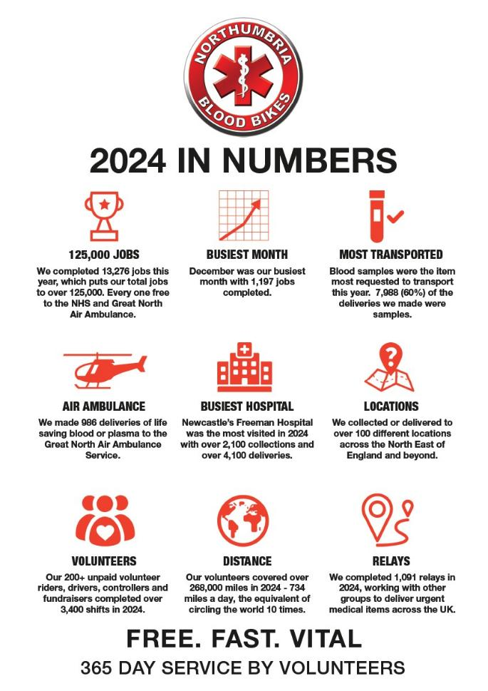




Registered Charity no. 1166689
www.northumbriabloodbikes.org.uk
Notes:
Cherry pick a couple of stats to speak about
Thank everyone

Slide 18
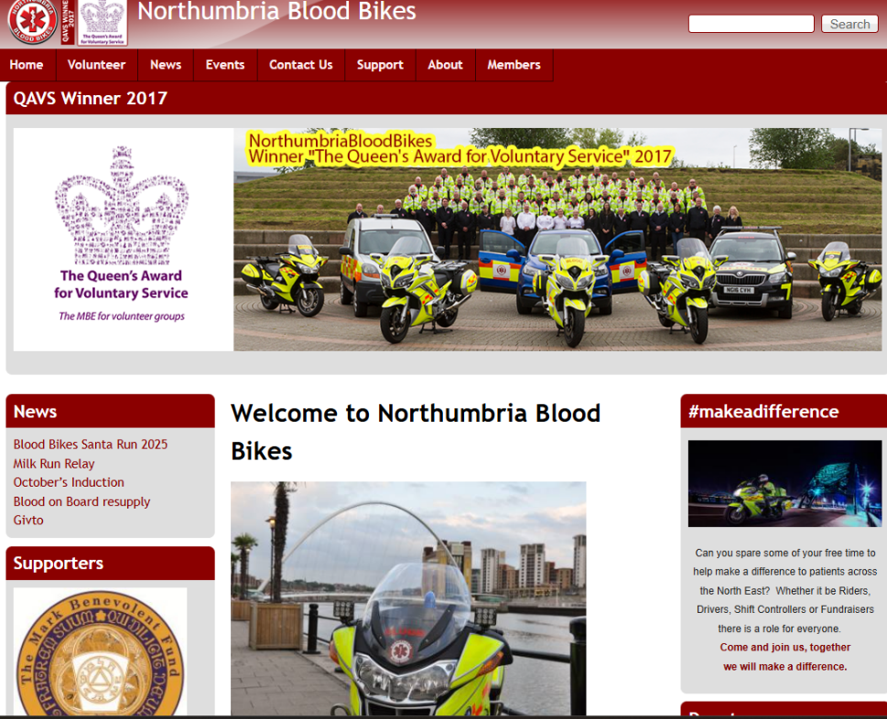




Closing Slide
NORTHUMBRIA BLOODBIKES
Registered Charity no. 1166689
www.northumbriabloodbikes.org.uk
Notes:
More information found on our website
Mention how to volunteer / request a speaker

Slide 19
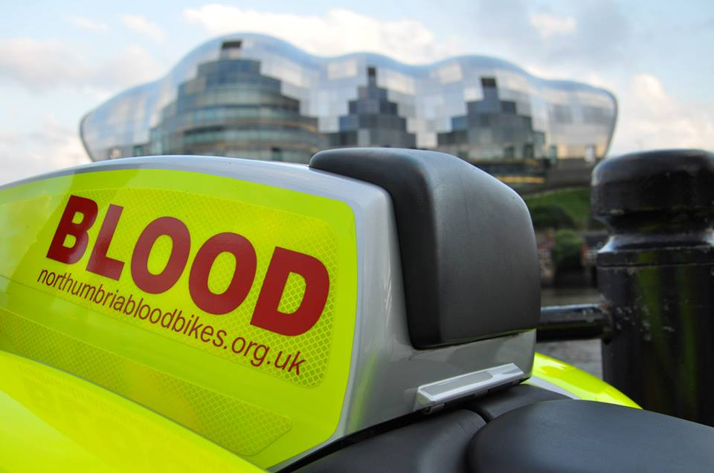
Closing Slide
Registered Charity no. 1166689
www.northumbriabloodbikes.org.uk
Notes:
Thank you

Slide 20

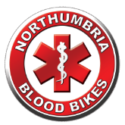



NORTHUMBRIA BLOODBIKES
Alone we can do so little; together we can do so much..
Hellen Keller
Registered Charity no. 1166689
www.northumbriabloodbikes.org.uk

