Slide 1
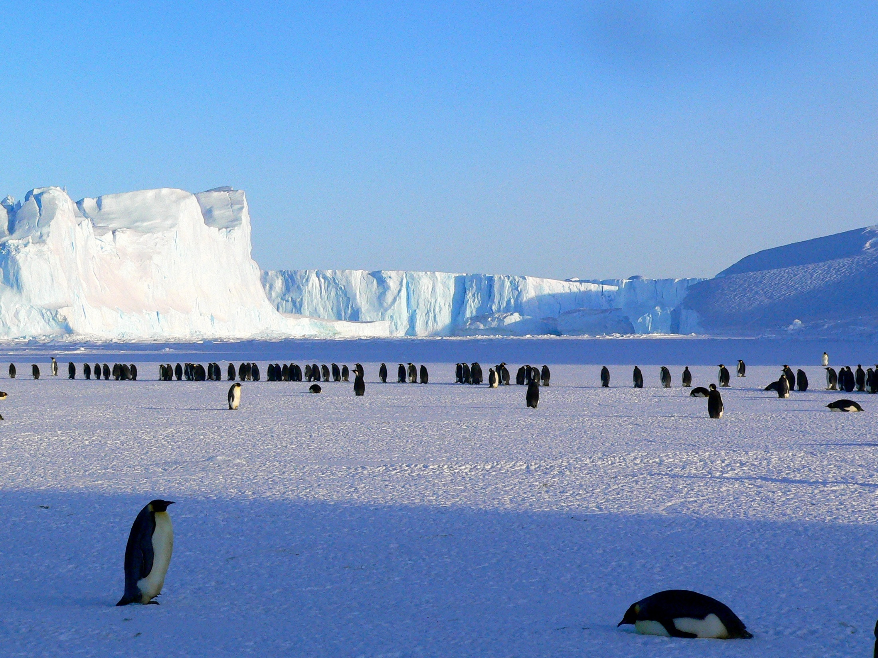
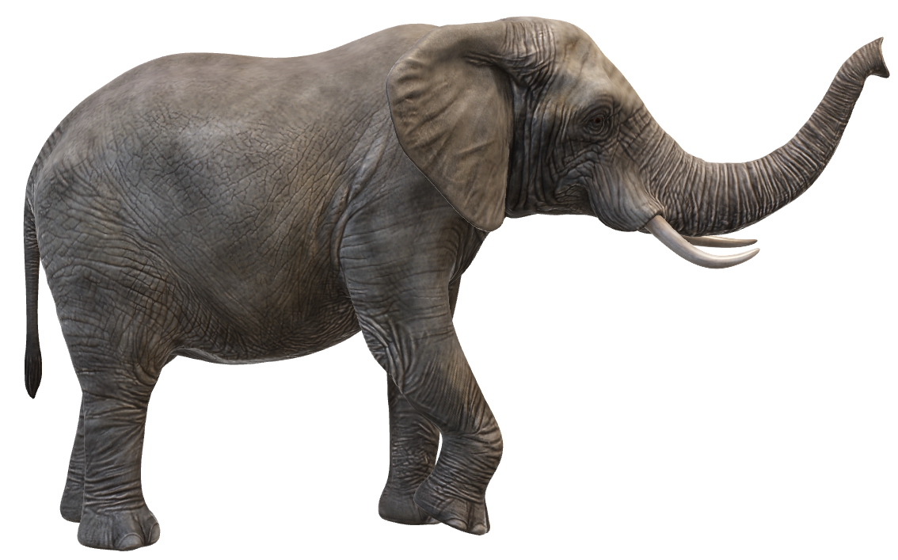
Notes:
To be used/not used ….. It’s up to the presenter.
I can tell you now that this is not one of our official slides ….. (long pause) ….. I can only think she’s up there to break the ice !

Slide 2
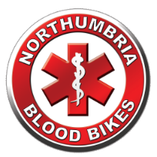

NORTHUMBRIA BLOODBIKES
Notes:
That’s more like it!!
Hello My Name is …………..
I’m a Rider / Driver / Fundraiser and Speaker with Northumbria Blood Bikes
And on behalf of Northumbria Blood Bikes, thank you for the opportunity to share our story with you
Straw Poll – “how many of you have heard of us or know what we do” well let's fill in the gaps

Slide 3
NORTHUMBRIA BLOODBIKES
Imagine you work for the NHS and you’re on duty at your local hospital …… it’s 3 O’Clock in the morning.
There’s been a Road Traffic Collision (RTC) and you’ve got a patient who urgently needs a blood transfusion but you haven't got enough blood, or you’ve not got the right type of blood, or you know there’s another patient being operated on at 7am and they’re going to need blood. Who are you going to call ?
I
Notes:
Let’s start with a scenario ………..

Slide 4

I
Notes:
WRONG !!! But thank you anyway, our audiences never let us down.

Slide 5
NHSBT
AMBULANCE
TAXI
BLOOD BIKE
Notes:
The only people you can call are this lot here
NHSBT generally works during the day, they can provide an out of hours service but we understand they charge £150 per delivery….. AND ….. they are funded separately from you local NHS trust, so the trust has to pay.
Ambulances are too busy dealing with the demand from patients and are under enough stress already, they are just not used for this type of work.
Taxis are an option, especially before the blood bikes were formed, but they charge commercial rates and there’s no guarantee of service. According to the taxi fare comparison website it costs £12 to go from the RVI to the Freeman Hospital … £21 after midnight. RVI to Sunderland Royal ?? £52 before midnight £66 after midnight. Just imagine how much it would cost to get an urgent sample from a patient in the infirmary in Berwick to the Path Lab at the RVI.
Blood Bikes are the preferred option. There is no cost to the NHS, we have service level agreements in place with our local NHS trusts, and if that isn’t enough, every single one of us is a volunteer ….. No six figure salaries for our chairman, no paid management team, no paid staff at all, all volunteers.

Slide 6
11
12
BLOOD BIKE
13
14
TAXI
1
NHSBT
AMBULANCE
Notes:
So almost without exception THIS is the order the hospitals use, with blood bikes the clearly preferred option.
AMBULANCE: Just too busy!
NHSBT: Not absolutely sure of the cost, but there is one! Funded separately from the local NHS trusts, so a cost to your NHS provider.
TAXI: Commercial rates. Ad Hoc response. No Accountability. Fingers crossed approach.
According to a taxi fare comparison website it costs £12 to go from the RVI to the Freeman Hospital … up to £21 after midnight. RVI to Sunderland Royal ?? £52 before midnight £66 after midnight. Just imagine how much it would cost to get an urgent sample from a patient in the infirmary in Berwick to the Path Lab at the RVI.
BLOOD BIKES: No cost to the NHS. Reliable. Accountable. Service Level Agreements in place. All volunteers - No six figure salaries for our chairman, no paid management team, no paid staff at all, all volunteers.

Slide 7
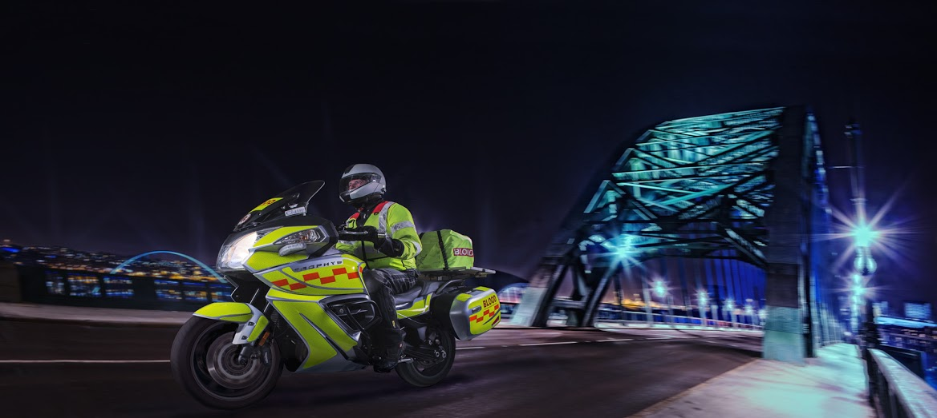

Who are we and what do we do ?
NORTHUMBRIA BLOODBIKES
We are a local charity
We provide an out of hours courier service to NHS hospitals and healthcare sites
We are independent of the NHS although we provide a service to them
Charity Commission Registration
“To advance health or save lives, primarily in Northumbria, by providing a volunteer courier service ancillary to transport provided by the statutory authorities for the transfer of blood, blood products and other medical resources between hospitals and medical facilities."
Notes:
We are a charity.
When the internal NHS couriers go home, hospitals rely on us to move urgent items out of hours. In fact not just urgent items, virtually anything that is needed out of hours.
We are not part of the NHS, or Blood and Transplant Service, but an independent charity working for the NHS and You.
Our charitable aim is to improve health and save lives.

Slide 8
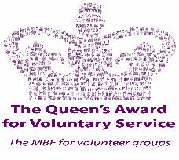
Background & History
NORTHUMBRIA BLOODBIKES
1962 First Blood Bike volunteer group established in Surrey
2008: Nationwide Association of Blood Bikes (NABB) established
2012: Northumbria Blood Bikes formed
2014 : 22 Blood bike groups in operation and NBB goes live
2017: NBB received Queen’s Award for Voluntary Service
2021: Over 13,000 jobs completed, with almost 9000 Covid related
2023: 100,000 JOB MILESTONE REACHED!
2024 : 13,200 jobs
2025: 13,891 Jobs
Notes:
First group formed in 1962 in Surrey called Emergency Volunteer Service (EVS)
QAVS is highest award given to volunteer groups
Discuss milestones and how many taxi fares have been saved ….. IF EVERY ONE OF THOSE JOBS IN 2025 WAS FROM THE RVI TO THE FREEMAN, BEFORE MIDNIGHT, IT WOULD HAVE COST THE NHS TRUSTS IN THE NORTH EAST £166,692 in Taxi Fares.

Slide 9
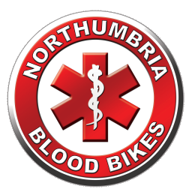
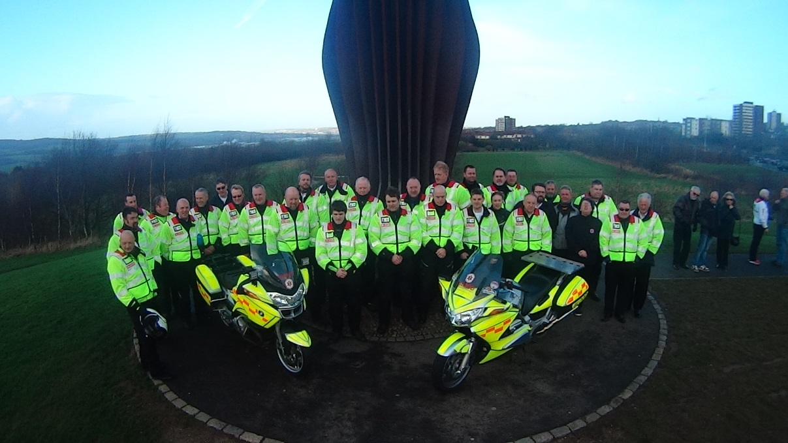
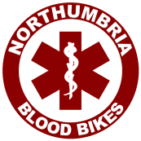
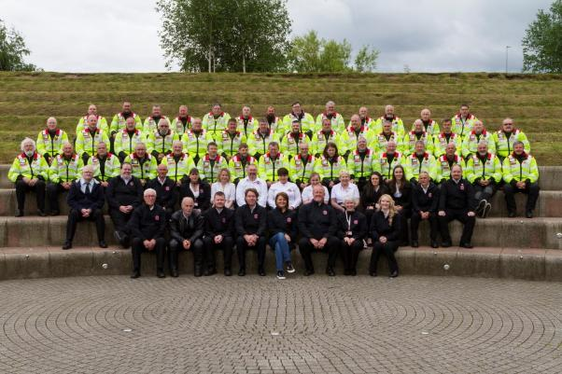
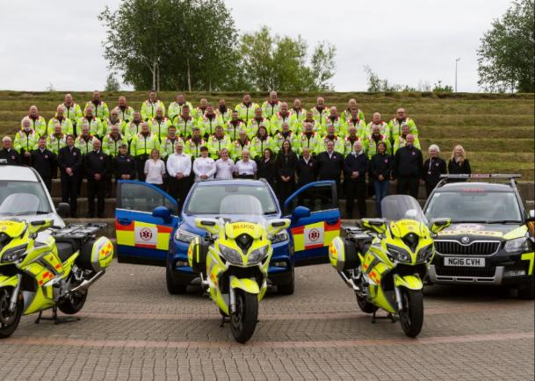
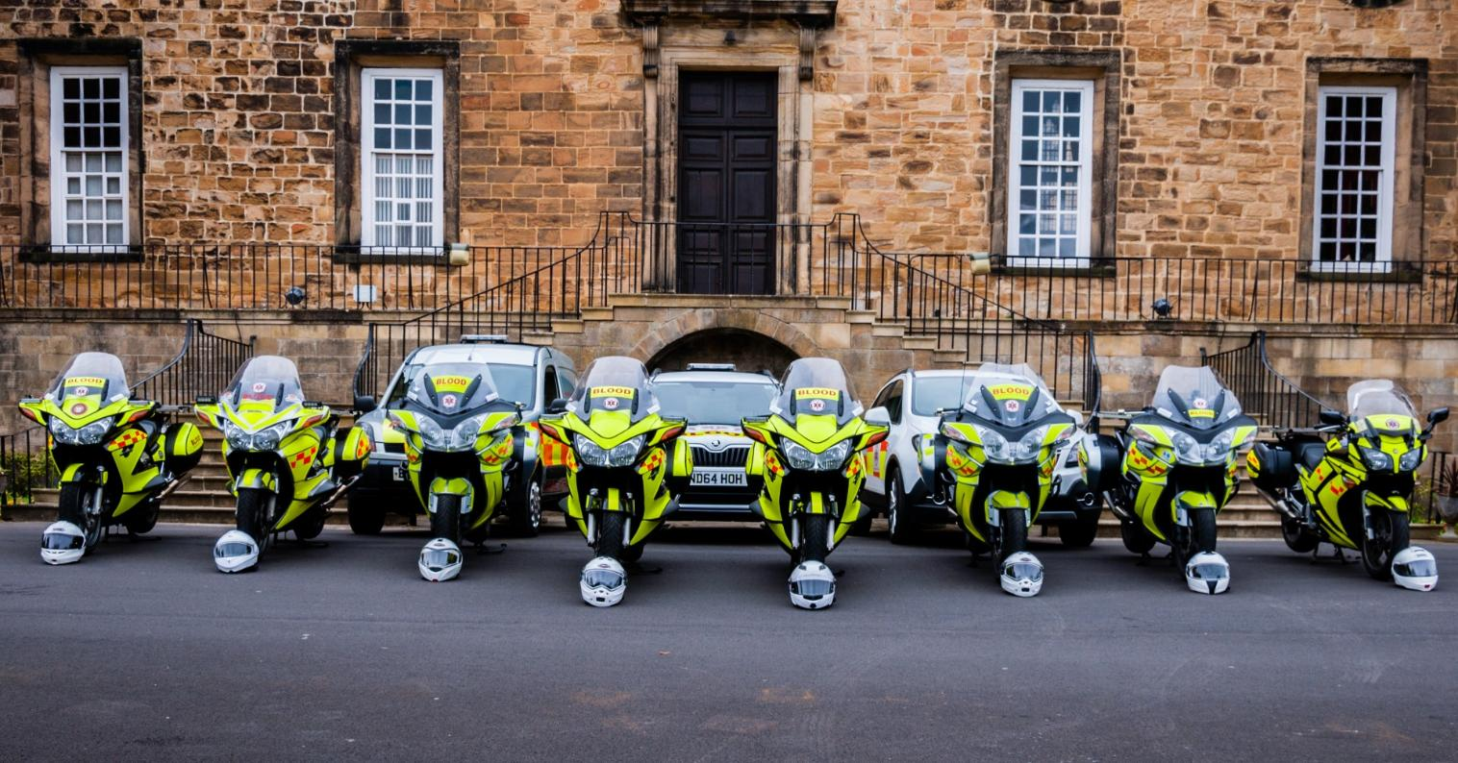



Photos Then and Now
Angel of the North Gateshead.
Sunday 2nd February 2014
(The day before we launched)
Registered Charity no. 1166689
Around 220 active members
112 Riders
124 Drivers
37 Fundraisers
44 Shift Controllers
www.northumbriabloodbikes.org.uk
Notes:
Feb 2014 this represented the complete fleet of vehicles - 2 motorcycles
there are 31 people in the photo (plus two taking photos) that represented about 90% of the membership at the time
You can see the fleet has grown considerably but even that photo now needs updated - The volunteers photo was taken early summer 2017 and we had around sixty people at the photoshoot – only now it represented just over 10% of the group.
While Carol Malia (Front and Centre) did wear her NBB fleece on the day – she clearly didn’t get the message about black trousers being part of the uniform☺

Slide 10
What do we do?
NORTHUMBRIA BLOODBIKES
Transport blood, platelets, specimens, samples, notes, equipment and people for the NHS. Breast milk for the UKAMB.
Generate our publicity, organise our fundraising, talks and awareness events, solicit donations and sponsorship from.. Anywhere and anyone!
Negotiate with Health Trusts, NEAS, NHSBT, GNAAS.
We are accountable, recording statistics and legally compliant administration, evidence-backed with receipts & records
Recruit and train our volunteers & run our fleet of vehicles.
Notes:
Delivering to hospitals is the visible part of our service, our equivalent of a swan moving serenely across a lake.
But we all know that swan is likely to be paddling furiously to get were they’re going, so …..everything else is what it takes to enable the service we deliver – paddling like mad under the water.

Slide 11
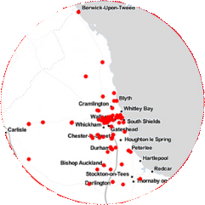
Our Coverage:
NORTHUMBRIA BLOODBIKES
We cover 7pm to 7am every day, 365 days per year.
Around the clock on weekends & public holidays
We cover over 100 locations in Northumberland, Tyne & Wear and County Durham
Notes:
More or less the medieval kingdom of Northumbria. (Originally it included North Yorkshire hence “North of the Humber Area”)
Our area of operations runs from Darlington in the South, West to the Cumbria border and North to the Scottish border and Berwick upon Tweed.
We can do relay runs with neighbouring groups.
We service over 100 locations in the region ….. That’s hospitals, Pathology Laboratories, Care Homes, Doctors Surgeries, The Newcastle Blood Bank, and even private homes (mostly collecting donated breast milk).

Slide 12
Our Funding:
NORTHUMBRIA BLOODBIKES
Service is completely free to the NHS
Our time is given for free
We receive no government or NHS contributions, we’re funded wholly by donations from the general public, sponsorship & events
Thousands of £££s in taxi & courier costs saved. Which are then invested into patient care, equipment, extra nurses etc
Running costs are over £12,000 per month - approx half of which is fuel
Notes:
While corporate and large donors sometimes fund major capital items like vehicles, it is much harder to get them to fund “running costs” as larger donors generally like to see what they are getting for their money and like to see their names on things they’ve sponsored. Therefore our “tin – rattling” events and the money that is generously donated at our talks, the smaller donations that cover our running costs, are absolutely vital to our work. (Although, of course, we don’t actually rattle our tins)

Slide 13
Why use Motorbikes?
NORTHUMBRIA BLOODBIKES
Good for negotiating traffic and filtering
Can use "No Car" lanes
Good fuel economy and reduced running costs
We promote the positive image of motorcycling
We also use cars; if ambient temperature falls below 3º C regulations prohibit carriage of blood by motorcycle.
Cars and our van are an integral part of our service.
Notes:
Filtering is legal in the UK
We can use “no Car” or Bus lanes except in Gateshead who don’t/won’t allow it.
In Newcastle we have dispensation for our cars to use the No-Car lanes in Emergencies
Our car fleet is now completely integrated into operations and we make no distinctions about their use, despite the charity still being called Northumbria Blood Bikes.

Slide 14
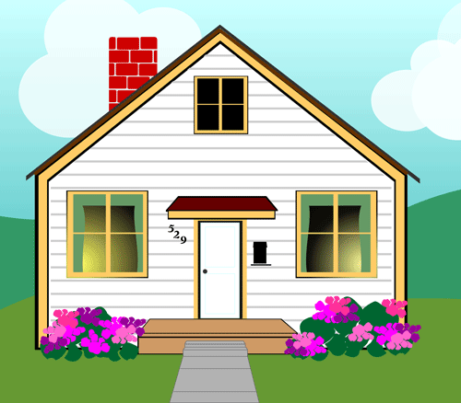
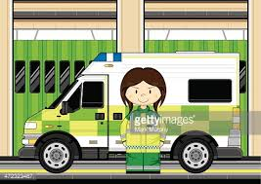

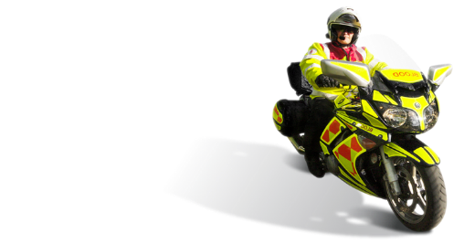
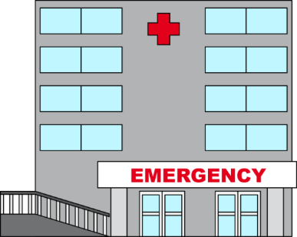
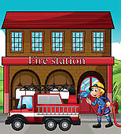
NORTHUMBRIA BLOODBIKES
How it works:
Our vehicles are based around the region.
Mostly at Ambulance and Fire stations.
A member will have booked a shift in advance and chosen a vehicle to use.
Rider drives his own vehicle to the base hosting the vehicle for his shift.
Rider checks over the blood bike ready for the shift to start.
If the base station has a crew room, the rider can wait there for a callout.
Otherwise they may return home and wait there for a callout.
Alternatively they may wait for a callout at one of the hospitals
Notes:
Here’s how it works ………..

Slide 15
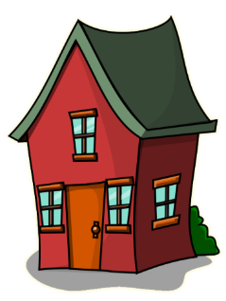


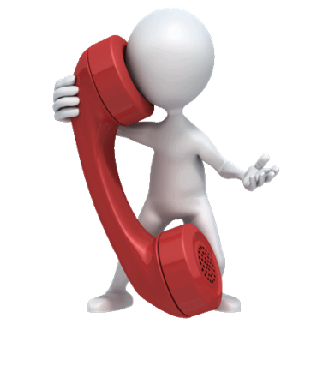

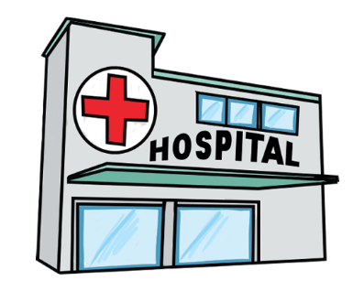
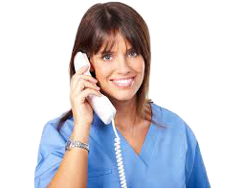
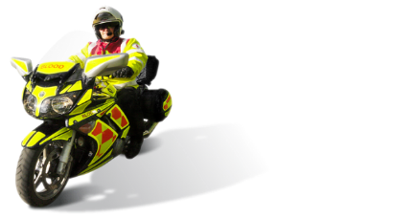
NORTHUMBRIA BLOODBIKES
How it works:
Hospitals / Trusts reach us through a ‘virtual number’ that forwards calls to the volunteer controller’s home.
Job details are taken and passed to the rider / driver.
Rider / driver collects and delivers the package keeping our controller informed.
Both controller and rider / driver log all details of the task onto our system as proof that the task is complete and to maintain stats.

Slide 16
Operating Methodology:
NORTHUMBRIA BLOODBIKES
Up to five vehicles per shift in operation
7 or 12 hour shifts at night and weekends/bank holidays.
Members carry photo ID and wear a branded uniform
Dedicated, liveried vehicles – we don’t use our own
Riders / drivers must hold an advanced riding or driving
(or both) qualification – annually assessed
All receive GMP Blood Handling training
Vehicles have tracking devices and CCTV fitted
Defibrillators in some vehicles
All paid for by fundraising and donations
Notes:
Explain the bullet points.

Slide 17

NORTHUMBRIA BLOODBIKES
Our fleet
Yamaha FJR 1300
BMW R1250RT
BMW F800 GT
Skoda Octavia Scout
Skoda Yeti
Toyota Corolla Hybrid
Yaris Cross Hybrid
Volkswagen Transporter
Notes:
Touring style bikes used due to..
Load carrying ability
Weather protection
Shaft Driven therefore no chain maintenance
Cars are mix of 4 x 4 and standard
No full electric vehicles but we do run several Hybrids which are proving successful

Slide 18
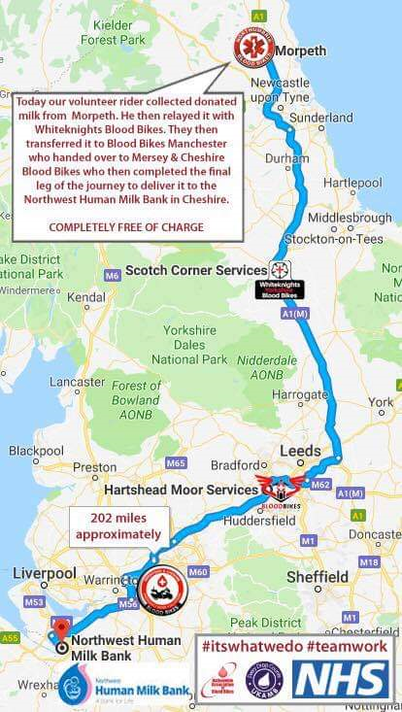
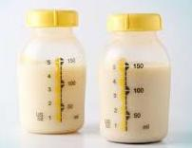
NORTHUMBRIA BLOODBIKES
Breast Milk relays
As part of a national network of blood bike groups, we help transport donated breast milk nationwide.
Morpeth to Northwest Human Milk Bank in Cheshire
  Northumbria Blood Bikes
  White Knights
  Blood Bikes Manchester
  Mersey & Cheshire Blood Bikes
  Distance 202 miles
Notes:
EXPLAIN A RECENT MILK RUN …..
A series of runs from Northumberland to the Human Milk Bank in Chester- this was a lady in Northumberland who sadly lost a very young baby. She decided to donate and continued to express milk which was frozen and taken to the Milk Bank in Chester. (There is no Human Milk Bank in the North East) We relayed with White Knights (Yorkshire), they relayed to the Manchester Group and Manchester relayed to Mersey and Cheshire Blood Bikes.
We know that a long distance relay from Liverpool to Newcastle which was sent by taxi by mistake cost the trust involved around £250.

Slide 19
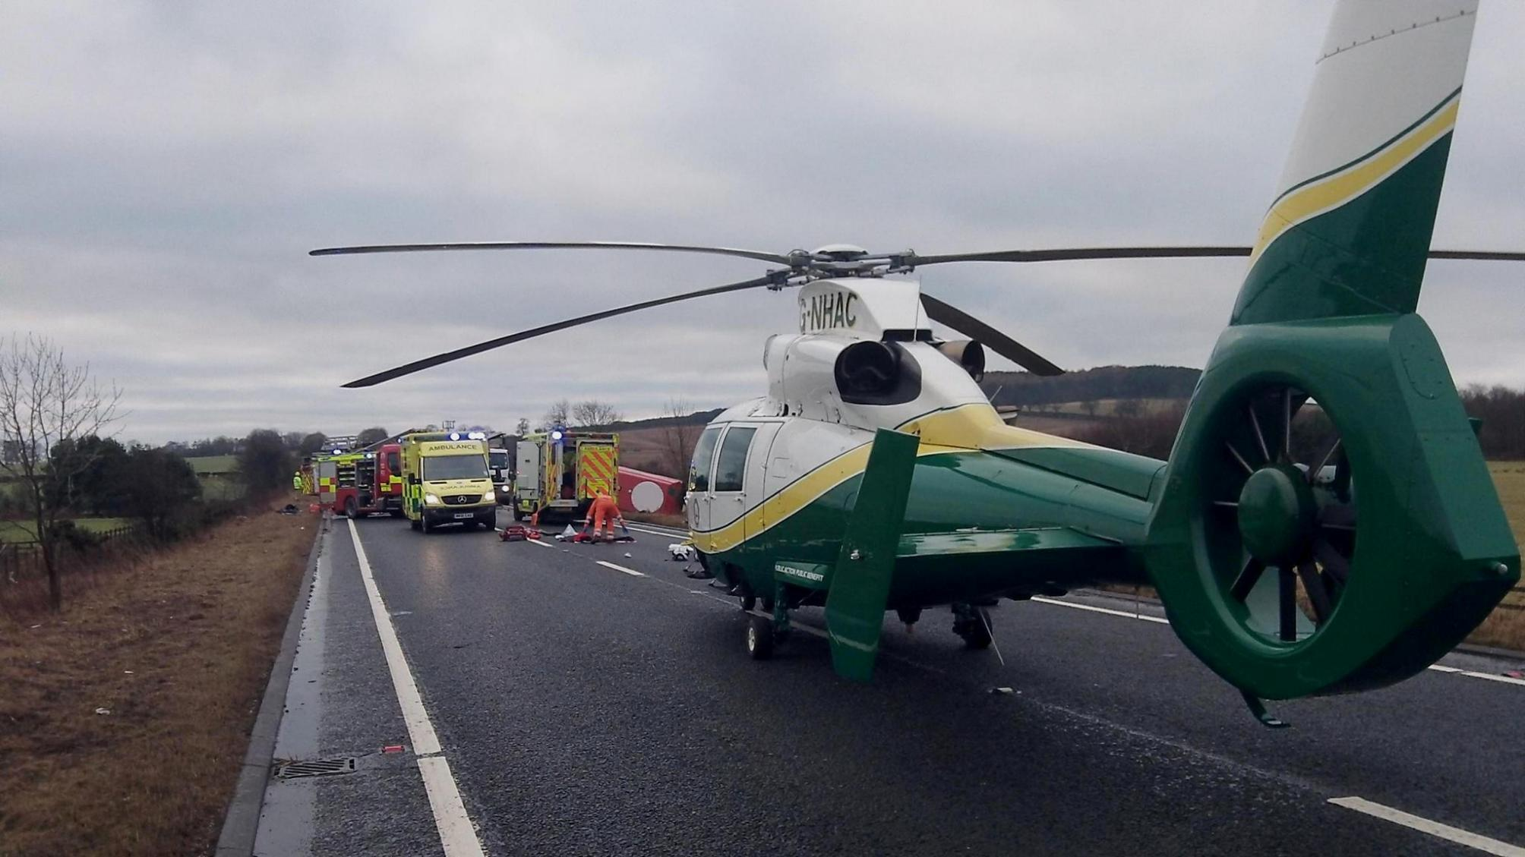
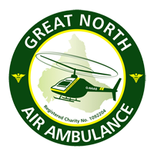
Blood On Board (“BoB”)
NORTHUMBRIA BLOODBIKES
Nightly delivery to both Great North Air Ambulance helicopters.
Enables transfusions at scene - Idea came from military operations in Afghanistan - "O negative" blood used – compatible with all blood types
Specially designed boxes maintain and monitor temperature for up to 48 hours
Transfused blood heated to body temperature on scene
Unused blood returned to hospitals & used in operations - No waste !
Notes:
Discuss each point

Slide 20
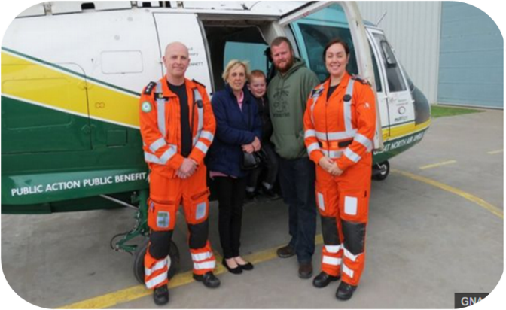
Blood On Board (“BoB”)
NORTHUMBRIA BLOODBIKES
Update from GNAAS
Used within 24hrs of launch in 2015
Around a third of transfusions contributed to survival
100% record on delivery, tracking and traceability
Scheme now expanded to HEMS car
Notes:
Taken from GNAAS website ………
Unexpected survivors – Jack’s Story: Just after 4.30 pm on 16th April 2023 Jack Godwin was coming home from Barnard Castle with his friend Ben when the car they were in crashed into a tree on the B6282 in Eggleston Co Durham. Due to the severity of the RTC several ambulances and two GNAAS helicopters were despatched to the scene.
Of the three patients Jack and Ben had both suffered life-threatening injuries and both were given life saving blood transfusions at the scene before being put into medically induced comas and flown separately to James Cook hospital in Middleborough and the RVI in Newcastle. Jack has suffered a torn Aorta, bleeds to the brain, serious brain swelling, a fracture to the bottom of his skull, a broken pelvis and a broken left elbow. The skill of the Doctors and Paramedics and the advanced equipment on the helicopters saved their lives, but it was the blood transfusions that gave paramedics the time for that work to be done. After some extensive treatment and rehabilitation both these young men went home to their families.
Mention the great work the Air Ambulance does ….. that it takes a lot of money to run it ….. that they have a significant funding operation and have a high profile among the public ….. BUT ….. compared to them we are a bit of a Cinderella service ….. we don’t enjoy the same profile as the Air Ambulance but we provide a vital part of the overall operation of the service, our fleet doesn’t need the same amount of funding they need and our bikes and cars are not quiet as sexy as their helicopters ……. but we still need support from the public to be able to provide our service.
Gauge the audience before talking about this point, we don’t want to upset anyone …………
Here’s a comparison between An Air Ambulance charity (it’s GNAAS but we don’t need to say that) and Northumbria Blood Bikes. Figures taken from the Charity Commission Website.
Air Ambulance NBB
Total Income: £10,998,131 £133,475
Paid Employees: 107 0
Volunteers 140 220
No of employees earning over £60k 7 0
No of employees earning over £250k 1 0

Slide 21
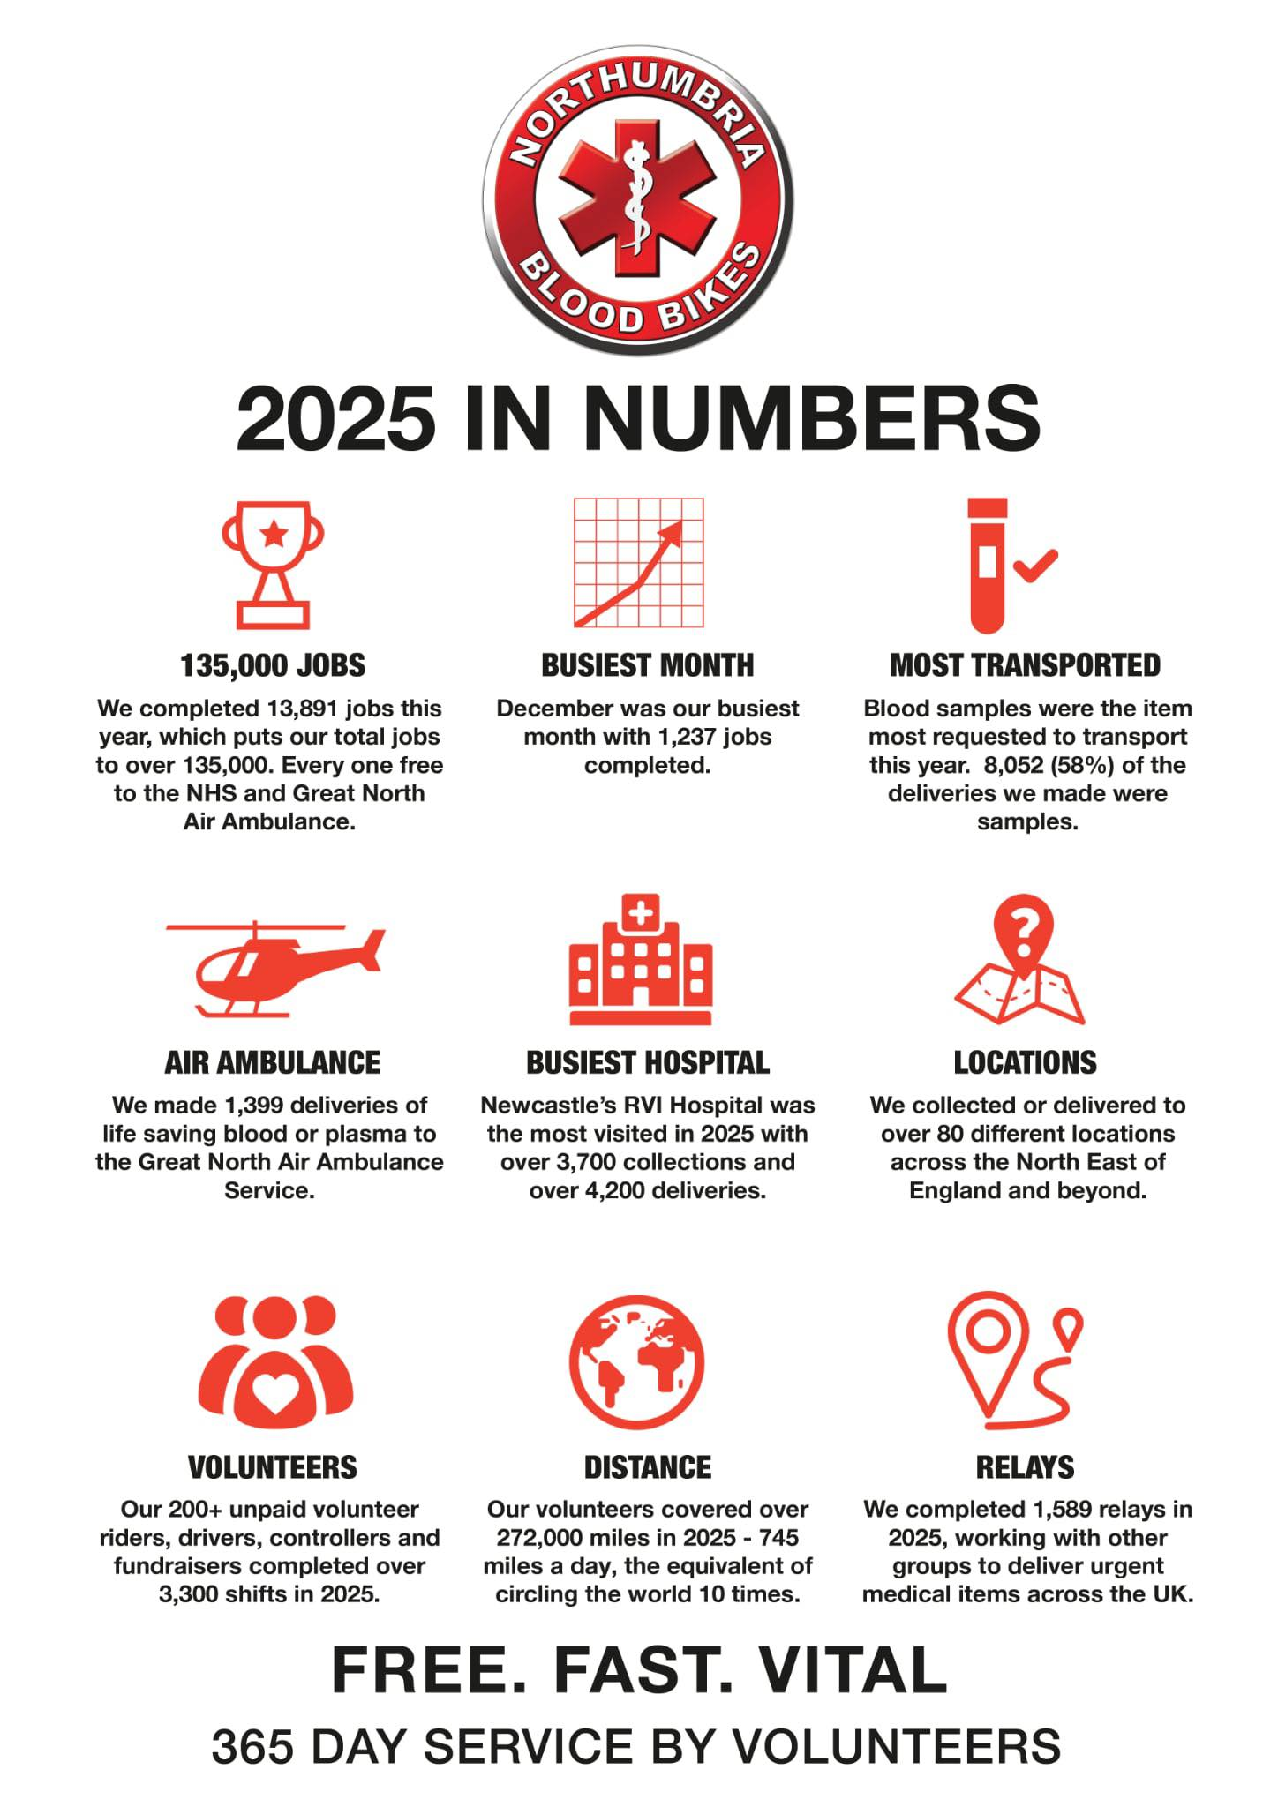




Registered Charity no. 1166689
www.northumbriabloodbikes.org.uk
Notes:
Cherry pick a couple of stats to speak about ….. In particular ….. NUMBER OF JOBS ….. AND ….. DISTANCES COVERED

Slide 22
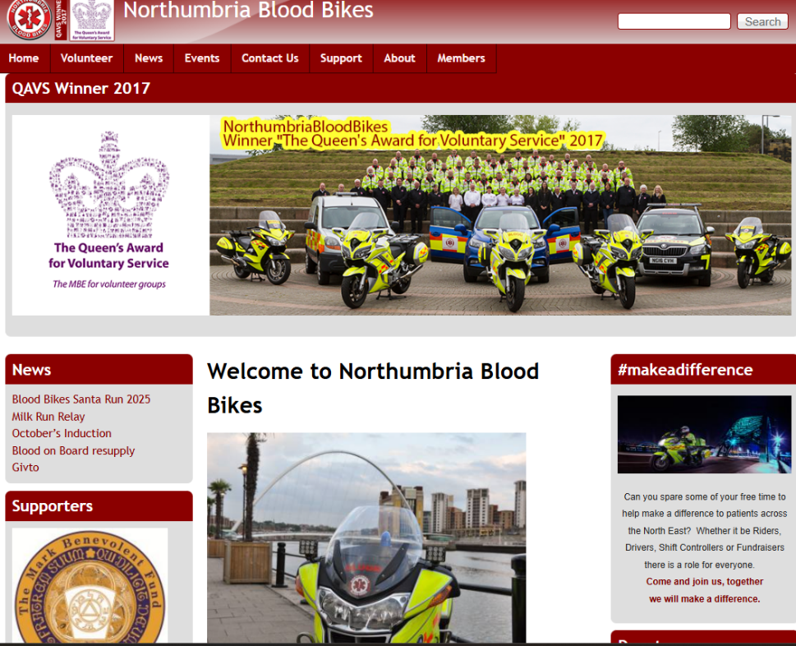




Closing Slide
NORTHUMBRIA BLOODBIKES
Registered Charity no. 1166689
www.northumbriabloodbikes.org.uk
Notes:
More information found on our website
Mention how to volunteer / request a speaker

Slide 23
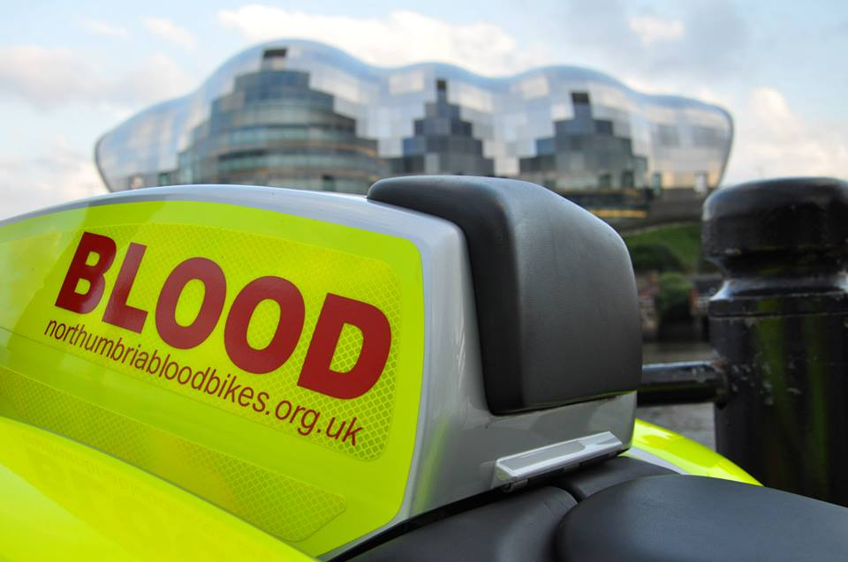
Closing Slide
Registered Charity no. 1166689
www.northumbriabloodbikes.org.uk
Notes:
I’ve said repeatedly throughout this presentation that we work for the NHS ……… but we don’t really ….. We work for you! Those 13,891 jobs completed in 2025?? There were 13,891 people on the receiving end, and affected by, those jobs.
Some of those jobs would have been relatively routine, delivering medication or medical notes from a hospital to a care home for example.
Some of those jobs would have been more important, delivering blood to the Air Ambulance or taking an urgent covid sample to a path lab for testing.
Some of those jobs would have been potentially life saving; Two that spring to mind for me ……… The First was a spinal fluid sample from a young child with suspected meningitis that went from Sunderland to the Path Lab at the Freeman at 5 O’Clock in the morning ….. The Second was the seven boxes of blood delivered to The Queen Elizabeth in Gateshead for a patient who we were told was on the operating table with a torn Aorta.
Real people's lives positively affected every day by the work we do ….. and that’s very rewarding.

Slide 24
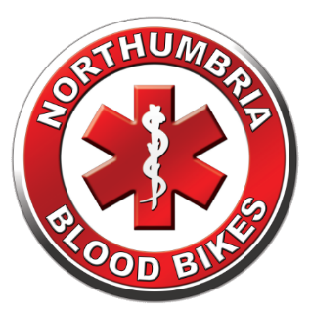
Northumbria Blood Bikes
AND FINALLY …………
Have you been on the back of one of our bikes ?
Notes:
AND FINALLY !!
Can I have a show of hands ………….. How many of you have been on the back of one of our bikes ?
Let me challenge that ….. If you’ve ever given blood, if you’ve ever had a blood transfusion, if you’ve ever had a sample taken, if you’ve ever had urgent notes delivered to your doctor or hospital, if you’ve ever donated breast milk, if any of your elderly relatives have been in a care home and needed medical notes, or medication or equipment from the hospital ….. and that’s happened after 7 O'clock at night or at the weekend, or on a bank holiday, you probably have been on the back of a blood bike (even if only in liquid form!)

Slide 25

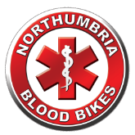



NORTHUMBRIA BLOODBIKES
Alone we can do so little; together we can do so much..
Hellen Keller
Registered Charity no. 1166689
www.northumbriabloodbikes.org.uk
Notes:
Thank you for listening ….. and more importantly thank you for your support ….. WE REALLY CAN’T DO IT WITHOUT YOU.

